Slide 1


Modern Operating Systems
Fifth Edition
Chapter 10
U N I X, L I N U X, AND ANDROID
Copyright © 2023, 2014, 2008 Pearson Education, Inc. All Rights Reserved
Notes:
If this PowerPoint presentation contains mathematical equations, you may need to check that your computer has the following installed:
1) Math Type Plugin
2) Math Player (free versions available)
3) NVDA Reader (free versions available)

Slide 2
History of U N I X and Linux
U N I C S
P D P-11 U N I X
Portable U N I X
Berkeley U N I X
Standard U N I X
M I N I X
Linux

Slide 3
U N I X/Linux Goals
Designed by programmers for programmers
Designed to be
Simple
Elegant
Consistent
Powerful
Flexible

Slide 4
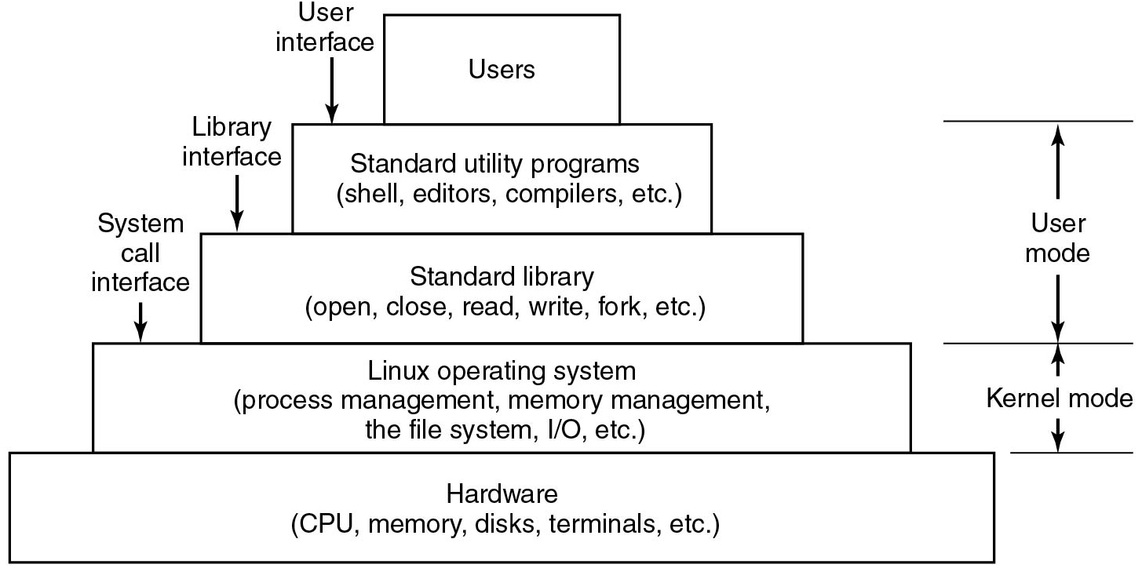
Interfaces to Linux
Figure 10.1 The layers in a Linux system.
Notes:
Long Description:
The figure consists of 5 layers. The first layer is labeled Users and the second layer is labeled Standard utility programs (shell, editors, compilers, etc.). A downward arrow is pointed toward the second layer and is labeled User interface. The third layer is labeled Standard library (open, close, read, write, fork, etc.) and a downward arrow is pointed toward the third layer labeled Library interface. The fourth layer is labeled Linux operating system (process management, memory management, the file system, I slash O, etc.) and a downward arrow is pointed toward the third layer is labeled System call interface. The fifth layer is labeled Hardware (C P U, memory, disks, terminals, etc.). The second and third layer is marked User mode and the third layer is marked Kernel mode.

Slide 5
Linux Utility Programs (1)
Categories of utility programs:
File and directory manipulation commands.
Filters.
Program development tools, such as editors and compilers.
Text processing.
System administration.
Miscellaneous.

Slide 6
Linux Utility Programs (2)
Program | Typical use
cat | Concatenate multiple files to standard output
chmod | Change file protection mode
cp | Copy one or more files
cut | Cut columns of text from a file
grep | Search a file for some pattern
head | Extract the first lines of a file
ls | List directory
make | Compile files to build a binary
mkdir | Make a directory
od | Octal dump a file
Figure 10.2 A few of the common Linux utility programs required by P O S I X. (Continues)

Slide 7
Linux Utility Programs (3)
Program | Typical use
paste | Paste columns of text into a file
pr | Format a file for printing
ps | List running processes
rm | Remove one or more files
rmdir | Remove a directory
sort | Sort a file of lines alphabetically
tail | Extract the last lines of a file
tr | Translate between character sets
Figure 10.2 A few of the common Linux utility programs required by P O S I X. (Continued)

Slide 8
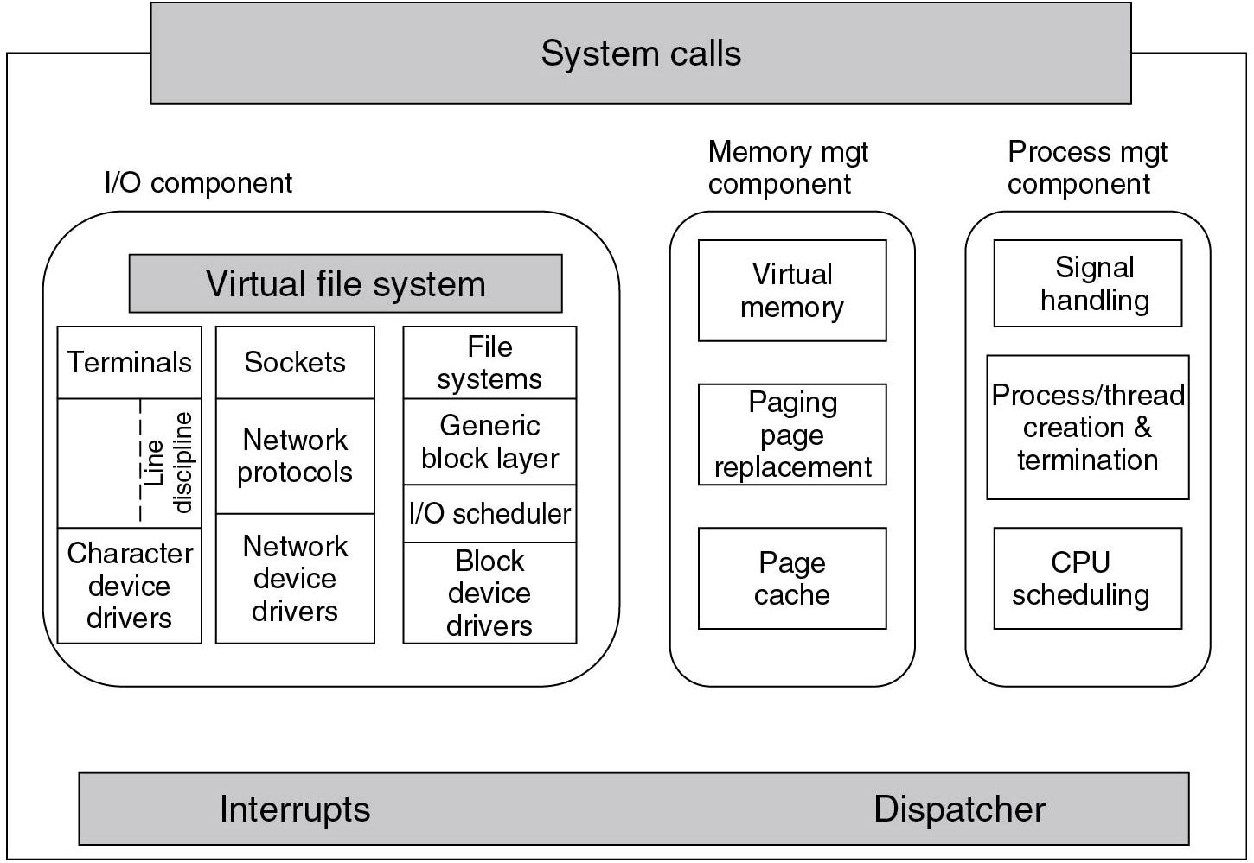
Kernel Structure
Figure 10.3 Structure of the Linux kernel
Notes:
Long Description:
The figure shows a rectangular block that consists of three sub-blocks labeled I bar O component, Memory mgt component, and Process mgt component. The block is titled with another rectangular block labeled System calls and it is shaded, also a rectangular block is placed at the end of the block and labeled Interrupts and Dispatcher. The I bar O component block has one horizontal sub-block labeled Virtual file system and three vertical sub-blocks. The first vertical sub-block is divided into three parts which are labeled Terminals, Line discipline, and Character device drivers. The second vertical sub-block is divided into three parts which are labeled Sockets, Network protocols, and network device drivers. The third vertical sub-block is divided into four parts which are labeled File systems, Generic block layer, I bar O scheduler and Block device drivers. Memory mgt component block has three sub-blocks labeled Virtual memory, Paging page replacement, and Page Cache. Process mgt component block has three sub-blocks labeled Signal handling, Process slash thread creation, and termination and C P U scheduling.

Slide 9
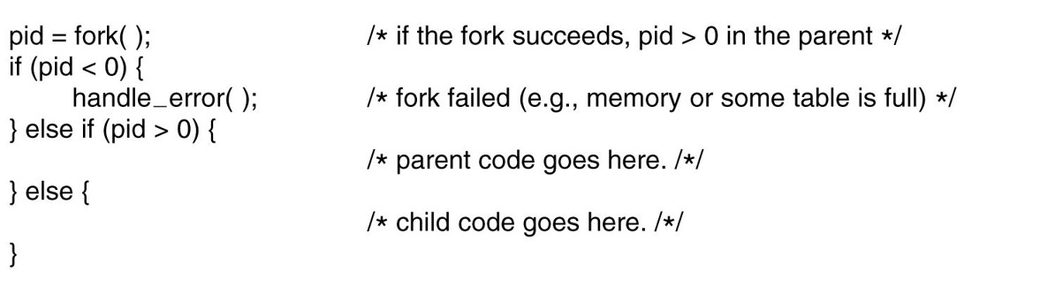
Processes in Linux
Figure 10.4 Process creation in Linux.
Notes:
Long Description:
pid equals fork open close parenthesis semi colon forward slash asterisk if the fork succeeds comma pid greater than 0 in the parent asterisk forward slash if open parenthesis pid less than 0 close parenthesis open curly bracket handle underscore error open close parenthesis semi colon forward slash asterisk fork failed open parenthesis e dot g dot comma memory or some table is full close parenthesis asterisk forward slash close curly bracket else if open parenthesis pid greater than 0 close parenthesis open curly bracket forward slash asterisk parent code goes here dot forward slash asterisk forward slash
close curly bracket else open curly bracket forward slash asterisk child code goes here dot forward slash asterisk forward slash

Slide 10
Signals in Linux
Signal | Cause
S I G A B R T | Sent to abort a process and force a core dump
S I G A L R M | The alarm clock has gone off
S I G F P E | A floating-point error has occurred (e.g., division by 0)
S I G H U P | The telecommunications connection was lost
S I G I L L | The process has tried to execute an illegal instruction
S I G Q U I T | The user has hit the key requesting a core dump
S I G K I L L | Sent to kill a process (cannot be caught or ignored)
S I G P I P E | The process has written to a pipe which has no readers
S I G S E G V | The process has referenced an invalid memory address
S I G T E R M | Used to request that a process terminate gracefully
S I G U S R 1 | Available for application-defined purposes
S I G U S R 2 | Available for application-defined purposes
Figure 10.5 The signals required by P O S I X.

Slide 11
Process Management System Calls in Linux
System call | Description
p i d = fork( ) | Create a child process identical to the parent
p i d = waitpid(p i d, &statloc, opts) | Wait for a child to terminate
s = execve(name, argv, envp) | Replace a process’ core image
exit(status) | Terminate process execution and return status
s = sigaction(sig, &act, &oldact) | Define action to take on signals
s = sigretur n(&context) | Return from a signal
s = sigprocmask(how, &set, &old) | Examine or change the signal mask
s = sigpending(set) | Get the set of blocked signals
s = sigsuspend(sigmask) | Replace the signal mask and suspend the process
s = kill(pid, sig) | Send a signal to a process
residual = alarm(seconds) | Set the alarm clock
s = pause( ) | Suspend the caller until the next signal
Figure 10.6 Some system calls relating to processes.

Slide 12
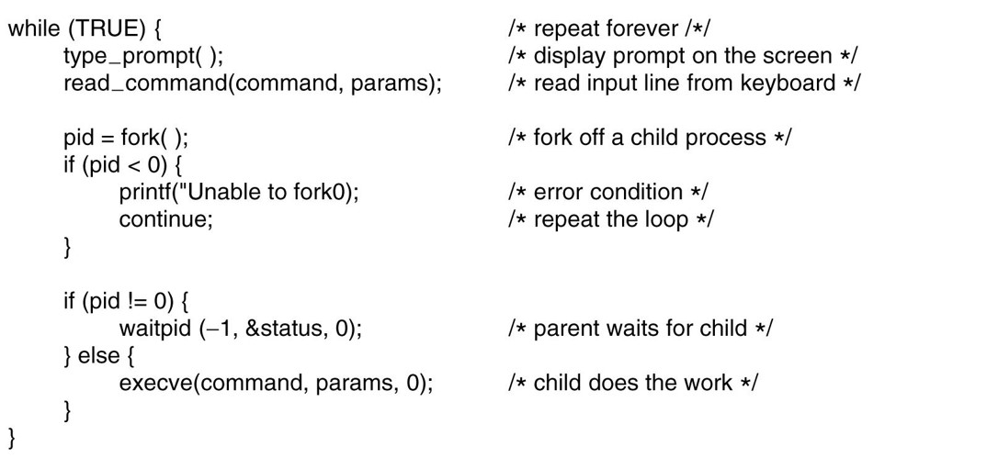
A Simple Linux Shell
Figure 10.7 A highly simplified shell.
Notes:
Long Description:
while open parenthesis TRUE close parenthesis open curly bracket forward slash asterisk repeat forever forward slash asterisk forward slash type underscore prompt open close parenthesis semi colon forward slash asterisk display prompt on the screen asterisk forward slash
read underscore command open parenthesis command comma params close parenthesis semi colon forward slash asterisk read input line from keyboard asterisk forward slash pid equals fork open close parenthesis semi colon forward slash asterisk fork off a child process asterisk forward slash if open parenthesis pid less than 0 close parenthesis open curly bracket printf open parenthesis double quote Unable to fork 0 close parenthesis semi colon forward slash asterisk error condition asterisk forward slash continue semi colon forward slash asterisk repeat the loop asterisk forward slash close curly bracket if open parenthesis pid exclamation mark equals 0 close parenthesis open curly bracket waitpid open parenthesis minus 1 comma ampersand status comma 0 close parenthesis semi colon forward slash asterisk parent waits for child asterisk forward slash close curly bracket else open curly bracket execve open parenthesis command comma params comma 0 close parenthesis semi colon forward slash asterisk child does the work asterisk forward slash close curly bracket

Slide 13
Implementation of Processes and Threads
Categories of information in the process descriptor:
Scheduling parameters
Memory image
Signals
Machine registers
System call state
File descriptor table
Accounting
Kernel stack
Miscellaneous

Slide 14
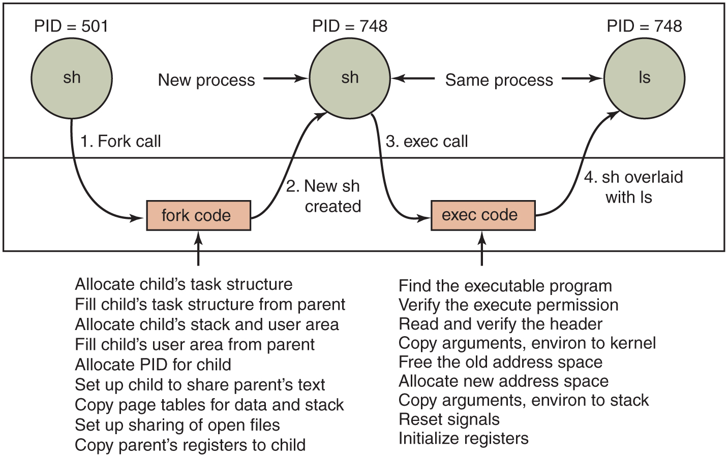
Implementation of Exec
Figure 10.8 The steps in executing the command ls typed to the shell.
Notes:
Long Description:
The figure shows a rectangular block that is divided into two layers. The first layer consists of three circles labeled sh, sh, and Is, they are again labeled P I D equals 501, P I D equals 748, and P I D equals 748. The second layer consists of two rectangular blocks labeled fork code and exec code. An arrow labeled New process is pointed to the second circle. Another arrow labeled the Same process is pointed to the second and third circles. An arrow is pointed to the fork code block and labeled Allocate child’s task structure Fill child’s task structure from parent Allocate child’s stack and user area Fill child’s user area from parent Allocate P I D for child Set up a child to share parent’s text Copy page tables for data and stack Set up sharing of open files Copy parent’s registers to the child. Another arrow is pointed to the exec code block and labeled Find the executable program Verify the execute permission Read and verify the header Copy arguments, environ to kernel Free the old address space Allocate new address space Copy arguments, environ to stack Reset signals Initialize registers. The steps are given as follows: 1. An arrow labeled Fork calls from the first circle to the fork code. 2. An arrow labeled New sh created from the fork code to the second circle. 3. An arrow labeled exec call from the second circle to the exec code. 4. An arrow labeled sh overlaid with Is from the exec code to the third circle.

Slide 15
The Clone System Call
Flag | Meaning when set | Meaning when cleared
CLONE_VM | Create a new thread | Create a new process
CLONE_F S | Share umask, root, and working dirs | Do not share them
CLONE_FILES | Share the file descriptors | Copy the file descriptors
CLONE_SIGHAND | Share the signal handler table | Copy the table
CLONE_PID | New thread gets old PID | New thread gets own PID
CLONE_PARENT | New thread has same parent as caller | New thread’s parent is caller
Figure 10.9 Bits in the sharing_flags bitmap.

Slide 16
Scheduling in Linux (1)
Three classes of threads for scheduling purposes:
Real-time F I F O
Real-time round robin
Timesharing

Slide 17
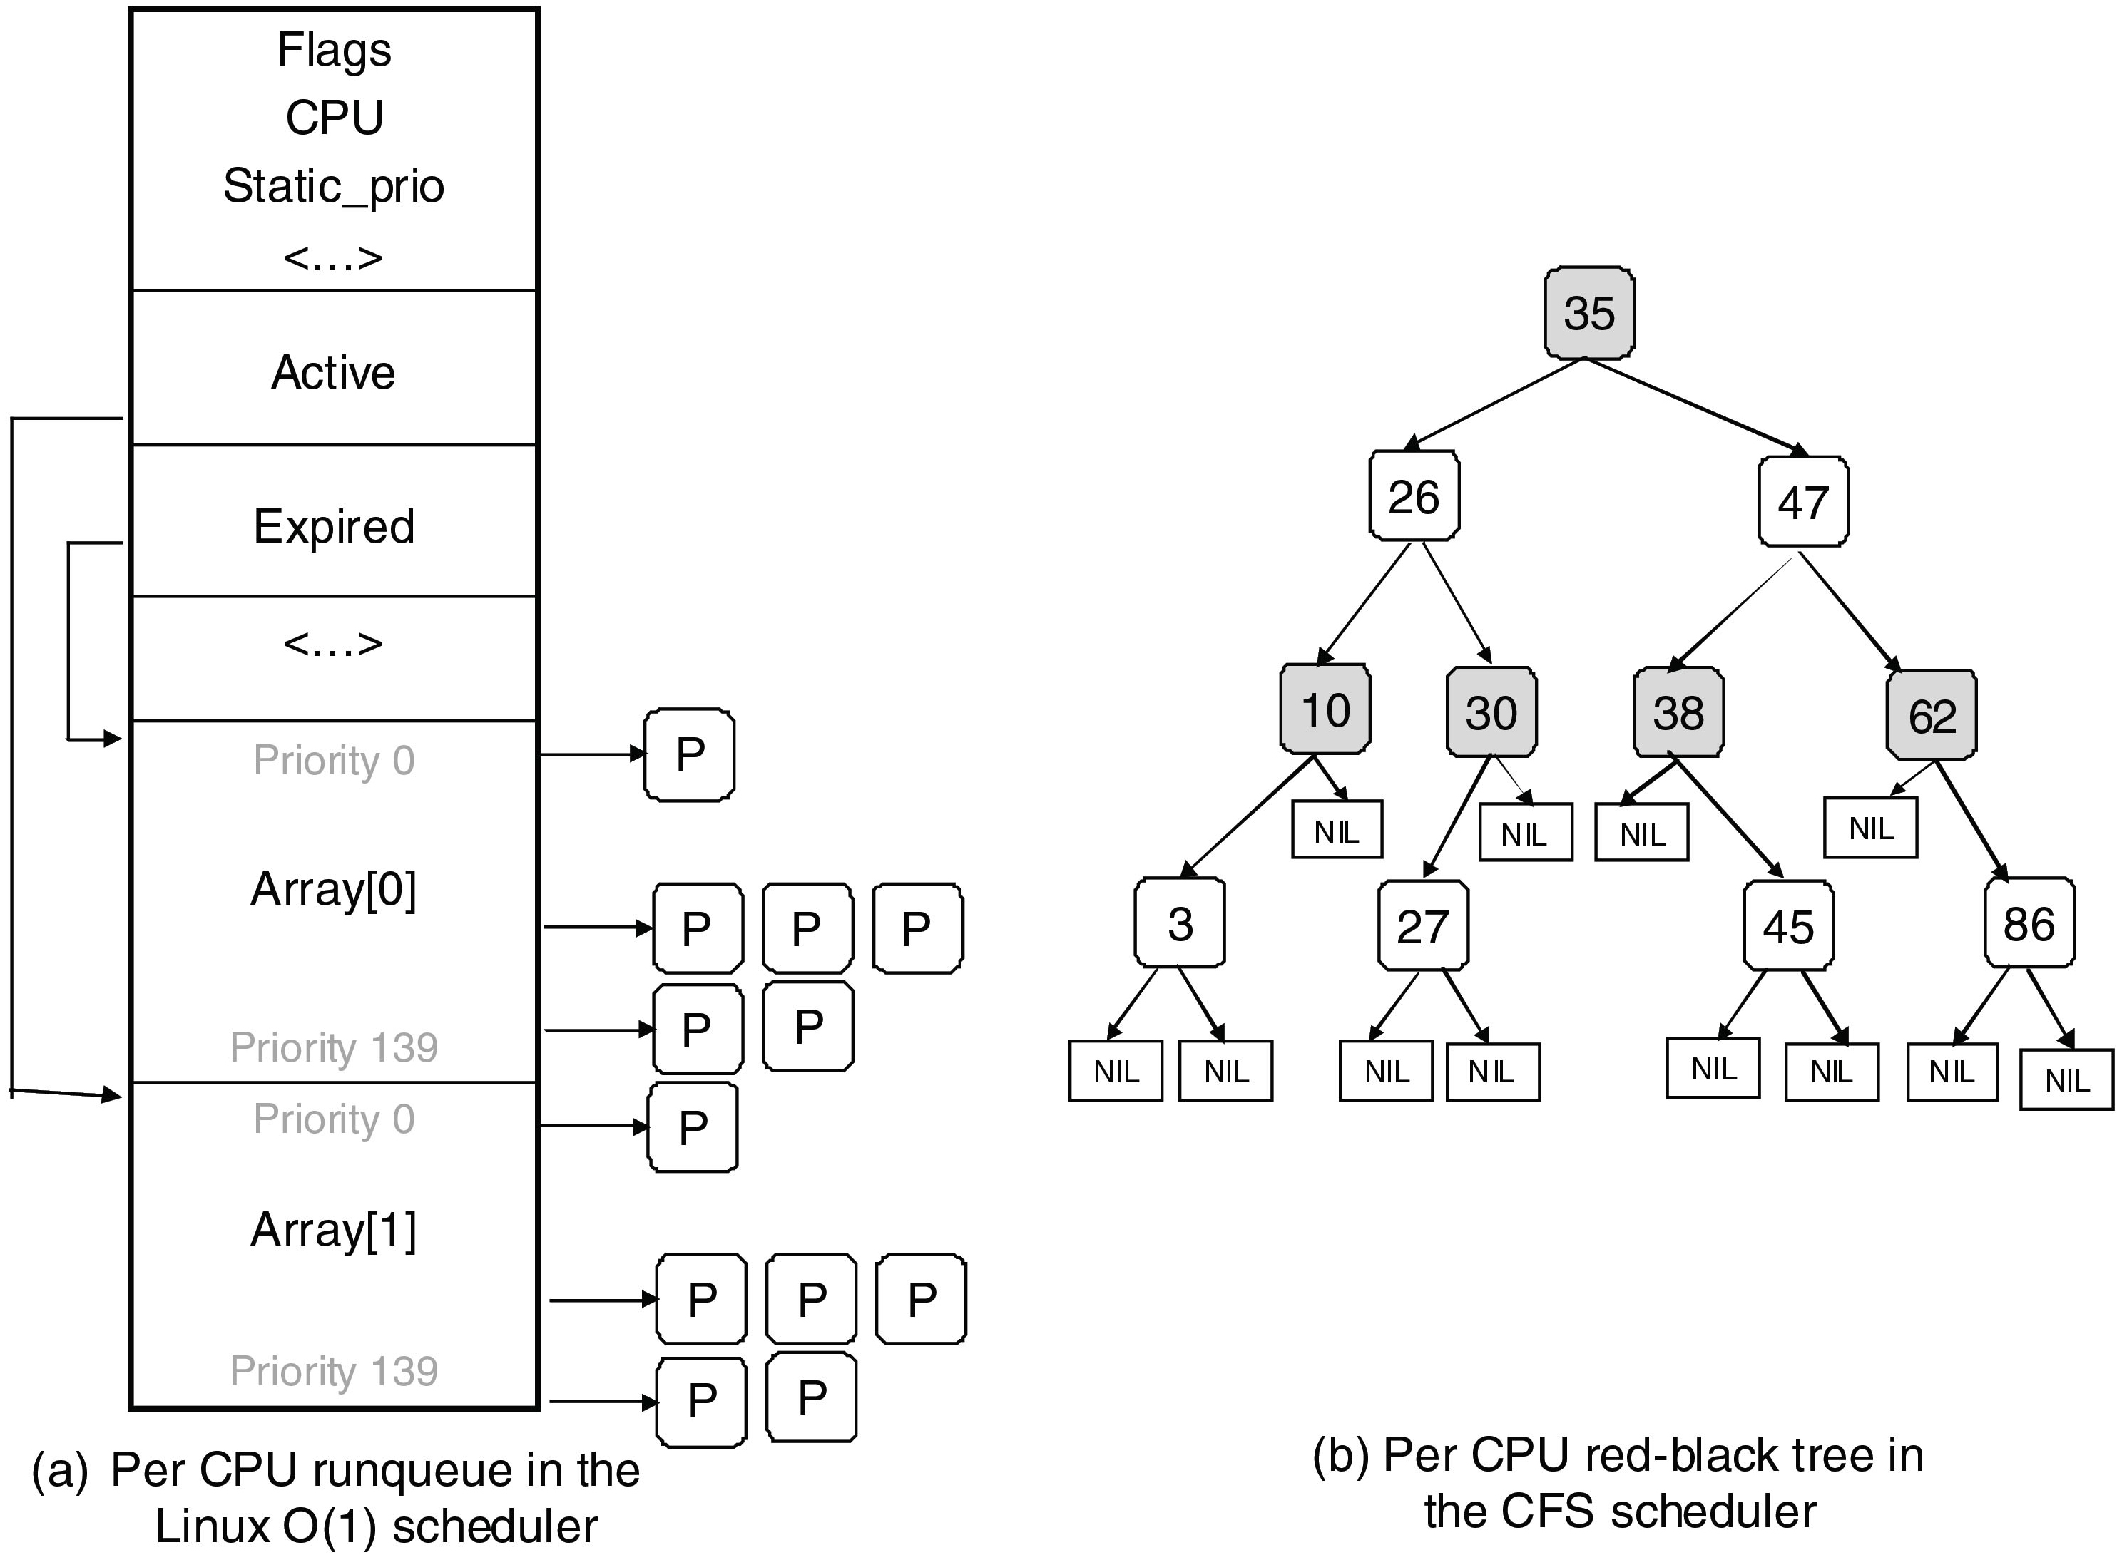
Scheduling in Linux (2)
Figure 10.10 Illustration of Linux runqueue and priority arrays.
Notes:
Long Description:
(a): The first figure shows a vertical block labeled Per C P U run queue in the Linux O(1) scheduler which is divided into six parts. The first part is labeled Flags, C P U, Static underscore prio, and <…>. The second part is labeled Active. The third part is labeled Expired. The fourth part is labeled <..>. The fifth part is labeled Priority 0, Array open square bracket 0 close square bracket, and Priority 139. The sixth part is labeled Priority 0, Array open square bracket 1 close square bracket, and Priority 139. An arrow is pointing from the second layer to the sixth layer. Another arrow is pointing from the third layer to the fifth layer. (b): The figure shows a tree labeled Per C P U red-black tree in the C F S scheduler. The tree diagram starts with the number 35. This block is connected to two blocks labeled 26 and 47. 26 is connected to two blocks labeled 10 and 30 and 47 is connected to two blocks labeled 38 and 62. 10 is connected to two blocks labeled 3 and NIL and 30 is connected to two blocks labeled 27 and NIL 38 is connected to two blocks 45 and NIL and 62 is connected to two blocks labeled 86 and NIL. 3 is connected to two blocks labeled NIL and NIL and 27 is connected to two blocks labeled NIL and NIL. 45 is connected to two blocks labeled NIL and NIL. 86 is connected to two blocks labeled NIL and NIL.

Slide 18
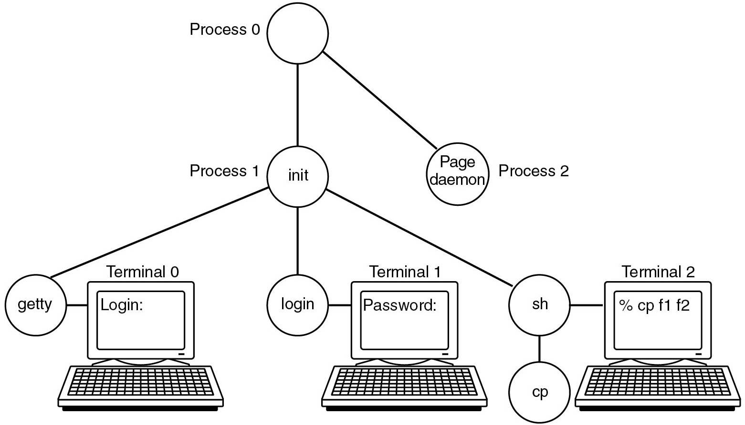
Booting Linux
Figure 10.11 The sequence of processes used to boot some Linux systems.
Notes:
Long Description:
The first figure (a) shows a vertical block labeled Per C P U run queue in the Linux O(1) scheduler which is divided into six parts. The first part is labeled Flags, C P U, Static_prio, and <…>. The second part is labeled Active. The third part is labeled Expired. The fourth part is labeled <..>. The fifth part is labeled Priority 0, Array[0], and Priority 139. The sixth part is labeled Priority 0, Array[1], and Priority 139. An arrow is pointing from the second layer to the sixth layer. Another arrow is pointing from the third layer to the fifth layer. Figure (b) shows a tree labeled Per C P U red-black tree in the C F S scheduler. The tree diagram starts with the number 35. This block is connected to two blocks labeled 26 and 47. 26 is connected to two blocks labeled 10 and 30 and 47 is connected to two blocks labeled 38 and 62. 10 is connected to two blocks labeled 3 and NIL and 30 is connected to two blocks labeled 27 and NIL 38 is connected to two blocks 45 and NIL and 62 is connected to two blocks labeled 86 and NIL. 3 is connected to two blocks labeled NIL and NIL and 27 is connected to two blocks labeled NIL and NIL. 45 is connected to two blocks labeled NIL and NIL. 86 is connected to two blocks labeled NIL and NIL.

Slide 19
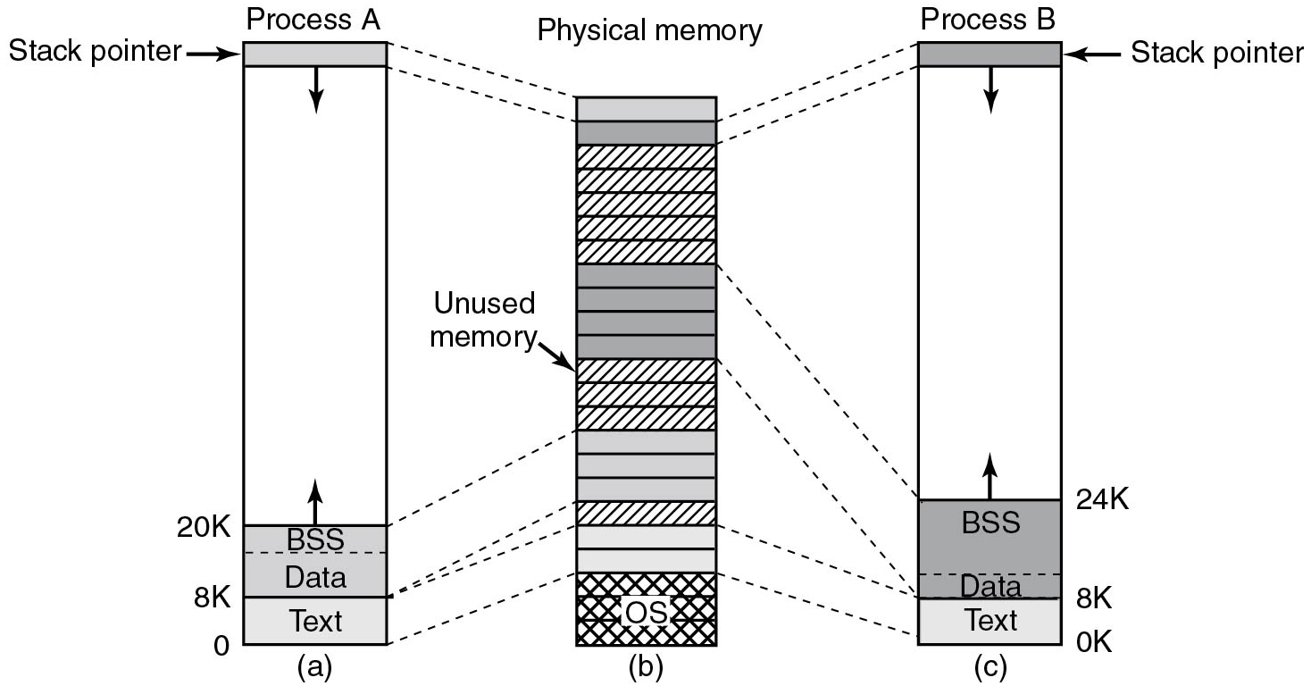
Memory Management in Linux (1)
Figure 10.12 (a) Process A’s virtual address space. (b) Physical memory. (c) Process B’s virtual address space.
Notes:
Long Description:
figure (a) shows a vertical block labeled Process A, the top of the block is consist of a stack that is shaded and an arrow is pointed downward from this stack and another arrow is pointed toward this stack and labeled Stack pointer. The bottom of the block is consist of two stacks which are labeled B S S, data, and Text, and shaded Text is ranging from 0 to 8 K, and Data and B S S is ranging from 8 K to 20 K. An arrow is pointed upward from the B S S block. Figure (b) shows a vertical block labeled Physical memory which is divided into 23 stacks. The stacks 1,2, 8,9,10,11, 15,16,17,19 and 20 are shaded. An arrow is pointed toward the 12th stack and labeled Unused memory. Figure (c) shows a vertical block labeled Process B the top of the block is consist of a stack that is shaded and an arrow is pointed downwards from this stack and another arrow is pointed toward this stack and labeled Stack pointer. The bottom of the block is consist of two stacks which are labeled B S S, data, and Text, and shaded Text is ranging from 0 to 8 K, and Data and B S S is ranging from 8K to 24 K. An arrow is pointed upward from the B S S block.

Slide 20
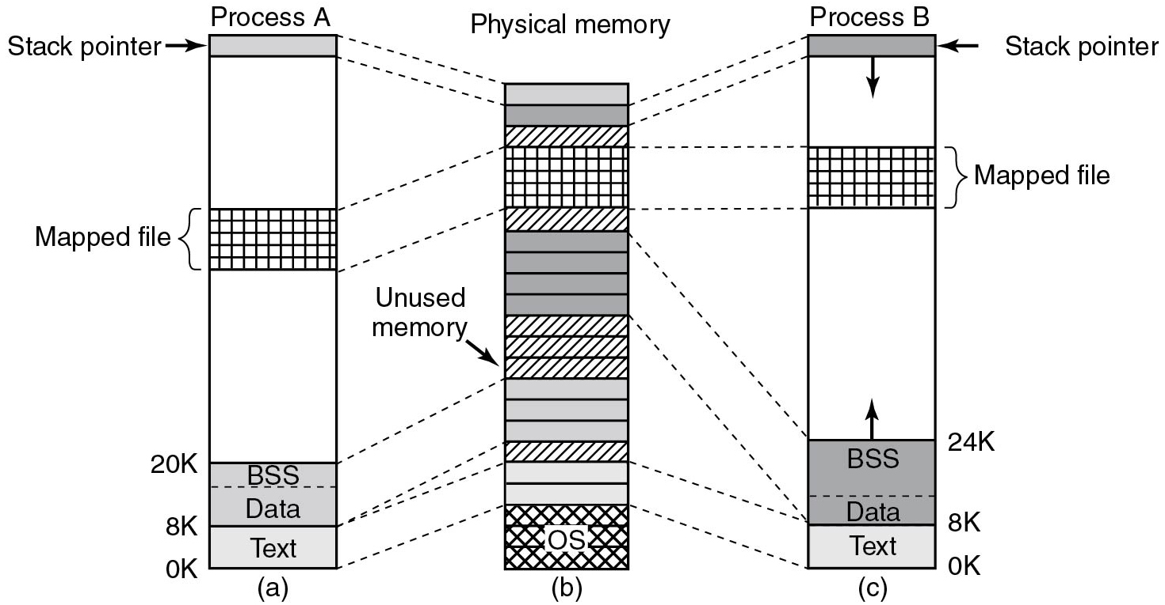
Memory Management in Linux (2)
Figure 10.13 Two processes can share a mapped file.
Notes:
Long Description:
Figure (a) shows a vertical block labeled Process A, the top of the block is consist of a stack that is shaded and an arrow is pointed downwards from this stack and another arrow is pointed toward this stack and labeled Stack pointer. The middle of the block consists of a stack labeled Mapped file. The bottom of the block is consist of two stacks which are labeled B S S, data, and Text, and shaded Text is ranging from 0 to 8K, and Data and B S S is ranging from 8K to 20K. An arrow is pointed upwards from the BSS block. Figure (b) shows a vertical block labeled Physical memory which is divided into 23 stacks. The stacks 1,2, 8,9,10,11, 15,16,17,19 and 20 are shaded. An arrow is pointed towards the 12th stack and labeled Unused memory. Figure (c) shows a vertical block labeled Process B the top of the block is consist of a stack that is shaded and an arrow is pointed downwards from this stack and another arrow is pointed toward this stack and labeled Stack pointer. The middle of the block consists of a stack labeled Mapped file. The bottom of the block is consist of two stacks which are labeled B S S, data, and Text, and shaded Text is ranging from 0 to 8K, and Data and B S S is ranging from 8K to 24K. An arrow is pointed upwards from the B S S block.

Slide 21
Memory Management System Calls in Linux
System call | Description
s = brk(addr) | Change data segment size
a = mmap(addr, len, prot, flags, fd, offset) | Map a file in
s = unmap(addr, len) | Unmap a file
Figure 10.14 Some system calls relating to memory management.

Slide 22
Physical Memory Management (1 of 3)
Linux distinguishes between three memory zones:
ZONE_D M A - pages that can be used for D M A operations.
ZONE_NORMAL - normal, regularly mapped pages.
ZONE_HIGHMEM - pages with high-memory addresses, which are not permanently mapped.

Slide 23
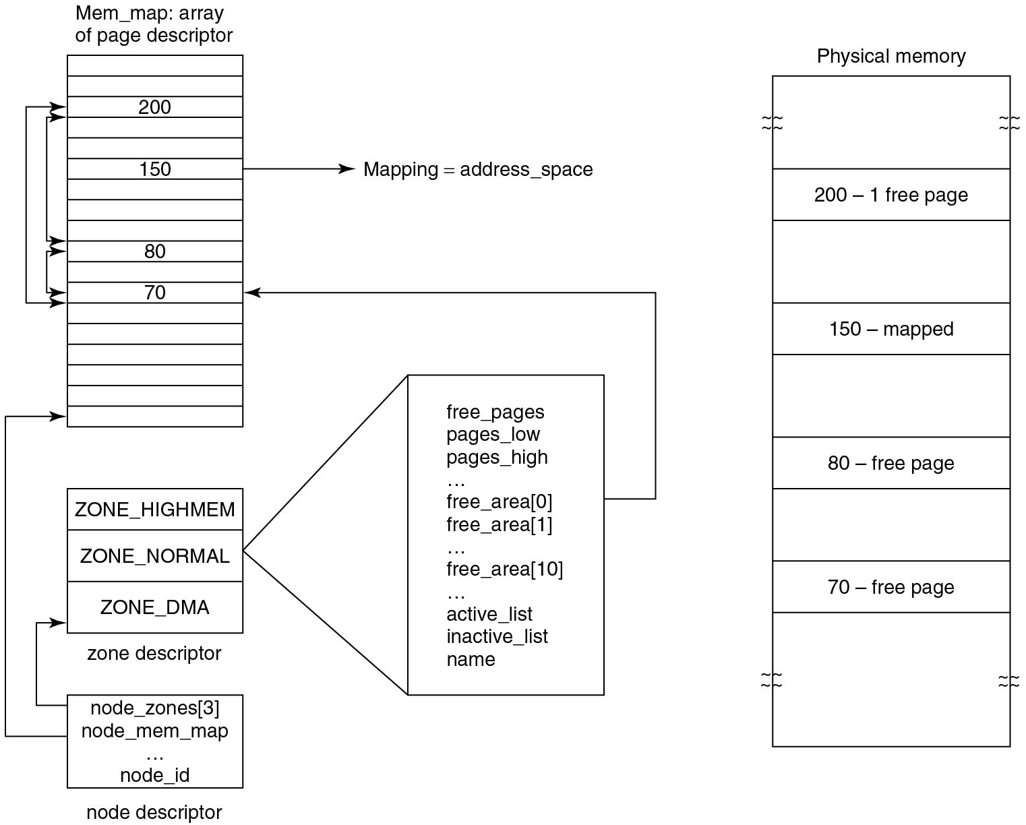
Physical Memory Management (2 of 3)
Figure 10.15 Linux main memory representation.
Notes:
Long Description:
The figure shows a vertical block that is divided into 18 stacks labeled Mem underscore map: array of page descriptors. The third stack is labeled 200, the sixth stack is labeled 150, the tenth stack is labeled 80, the twelfth stack is labeled 70 and all other stacks are blank. A two-sided arrow is connected between stacks of 200 and 70, 80 and 70, 200 and 80. A rectangular block is labeled node descriptor and inside the block is labeled node underscore zones open square bracket 3 close square bracket node underscore mem underscore map … node underscore id. A one-sided arrow is pointing from the node descriptor block to the bottom of the vertical block. A rectangular block is labeled zone descriptor which is divided into three parts that are labeled ZONE HIGHMEM, ZONE NORMAL, and ZONE D M A. A one-sided arrow is pointing from the node descriptor block to the zone descriptor block. ZONE NORMAL is connected to a rectangular block that is labeled free underscore pages pages underscore low pages underscore high … free underscore area open square bracket 0 close square bracket free underscore area open square bracket 1 close square bracket … free underscore area open square bracket 10 close square bracket free underscore area open square bracket 10 close square bracket active underscore list inactive underscore list name . A one-sided arrow is pointing from this block to the stack that is labeled 70. A one-sided arrow is pointing from stack 150 to the right side and labeled Mapping equals address space. The right side of the figure shows a vertical rectangular block labeled Physical memory which is divided into nine parts. The first part is blank, the second part is labeled 200 – 1 free page, the third part is blank, the fourth part is labeled 150 – mapped, the fifth part is blank, the sixth part is labeled 80 – free page, the seventh part is blank, the eight-part is labeled 70 – free page, and the ninth part is blank.

Slide 24
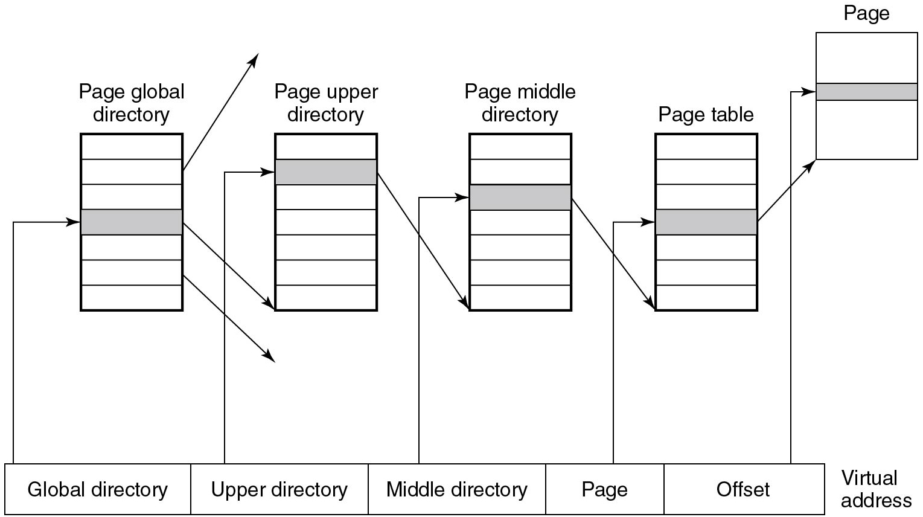
Physical Memory Management (3 of 3)
Figure 10.16 Linux uses four-level page tables.
Notes:
Long Description:
The figure shows a horizontal block labeled Virtual address and it is divided into five parts labeled Global directory, Upper directory, Middle directory, Page, and Offset. An arrow is pointing from the Global directory to a vertical rectangular block labeled Page global directory which is divided into seven segments and the fourth segment is shaded. A one-sided arrow is pointed downwards from the sixth segment. Another one-sided arrow is pointed upward from the second segment. An arrow is pointing from the Upper directory to a vertical rectangular block labeled Page upper directory which is divided into seven segments and the second segment is shaded. An arrow is pointing from the fourth segment of the Page global directory to the seventh segment of the Page upper directory. A one-sided arrow is pointing from the Middle directory to a vertical rectangular block labeled Page Middle directory which is divided into seven segments and the third segment is shaded. Another one-sided arrow is pointing from the second segment of the Page Upper directory to the seventh segment of the Page Middle directory. A one-sided arrow is pointing from the Page block to a vertical rectangular block labeled Page Table which is divided into seven segments and the fourth segment is shaded. Another one-sided arrow is pointing from the third segment of the Page Middle directory to the seventh segment of the Page Table. A one-sided arrow is pointing from the Page block to a vertical rectangular block labeled Page which consists of one segment that is shaded. Another one-sided arrow is pointing from the fourth segment of the Page table to the Page Block.

Slide 25
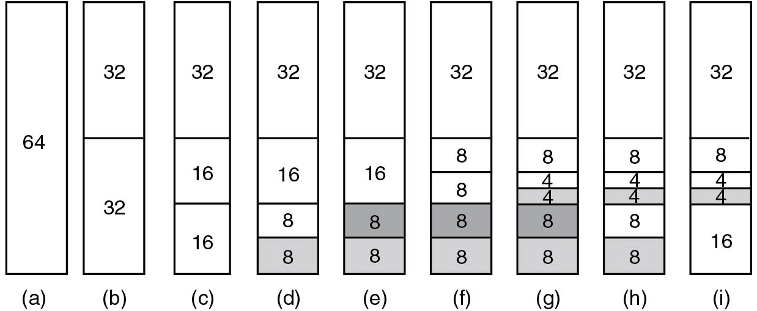
Memory Allocation Mechanisms
Figure 10.17 Operation of the buddy algorithm.
Notes:
Long Description:
The figure consist of nine vertical blocks which are labeled (a), (b), (c), (d), (e), (f), (g), (h) and (i). The first vertical block is labeled 64. The second block is divided into two parts and labeled 32 and 32. The third block is divided into two parts, the first part is labeled 32 and the second part is again divided into two parts which are labeled 16 and 16. The fourth block is divided into two parts, the first part is labeled 32 and the second part is again divided into two parts which are labeled 16, and the other part is again divided into two parts which are 8 and 8 in which one part is shaded. The fifth block is divided into two parts, the first part is labeled 32, and the second part is again divided into two parts which are labeled 16 and the other part is again divided into two parts which are 8 and 8 in which one part is shaded. The sixth block is divided into two parts, the first part is labeled 32 and the second part is again divided into four parts labeled 8, 8, 8, and 8 in which the last two parts are shaded. The seventh block is divided into two parts, the first part is labeled 32, and the second part is again divided into four parts, the first part is labeled 8, the second part is again subdivided into two parts labeled 4 and 4, the third part is labeled 8 and the fourth part is labeled 8 and last three parts are shaded. The eighth block is divided into two parts, the first part is labeled 32, and the second part is again divided into four parts, the first part is labeled 8, the second part is again subdivided into two parts labeled 4 and 4 which is shaded, the third part is labeled 8 and the fourth part is labeled 8 and shaded. The ninth block is divided into two parts, first, part is labeled 32 and the second part is again divided into two parts, the first part is again subdivided into two parts labeled 8 and the next part is subdivided into two parts labeled 4 and 4 which is shaded, the third part is labeled 16.

Slide 26
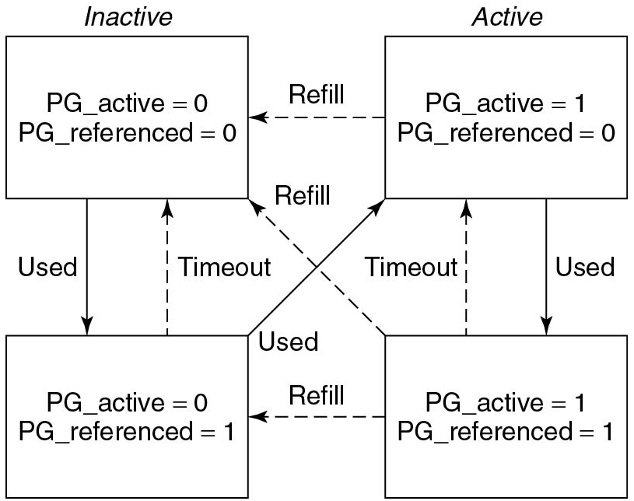
The Page Replacement Algorithm
Figure 10.18 Page states considered in the page frame replacement algorithm.
Notes:
Long Description:
The figure consists of four rectangular blocks, the first block is inactive and labeled P G underscore active equals 0, P G underscores referenced equals 0. The second block is placed below the first block and labeled P G underscore active equals 0, P G underscores referenced equals 1. An arrow is pointing from the first block to the second block which is labeled Used and a dotted lined arrow is pointing from the second block to the first block which is labeled Timeout. The third block is active and labeled P G underscore active equals 1, P G underscore referenced equals 0, and the fourth block is labeled P G underscore active equals 1, P G underscore referenced equals 1. An arrow is pointing from the third block to the fourth block which is labeled Used and a dotted lined arrow is pointing from the fourth block to the third block which is labeled Timeout. An arrow is pointing from the fourth block to the third block and the second block to the first block which is labeled Refill. An arrow is pointing from the third block to the first block which is labeled Used and a dotted arrow is pointing from the fourth block to the second block is labeled Refill.

Slide 27
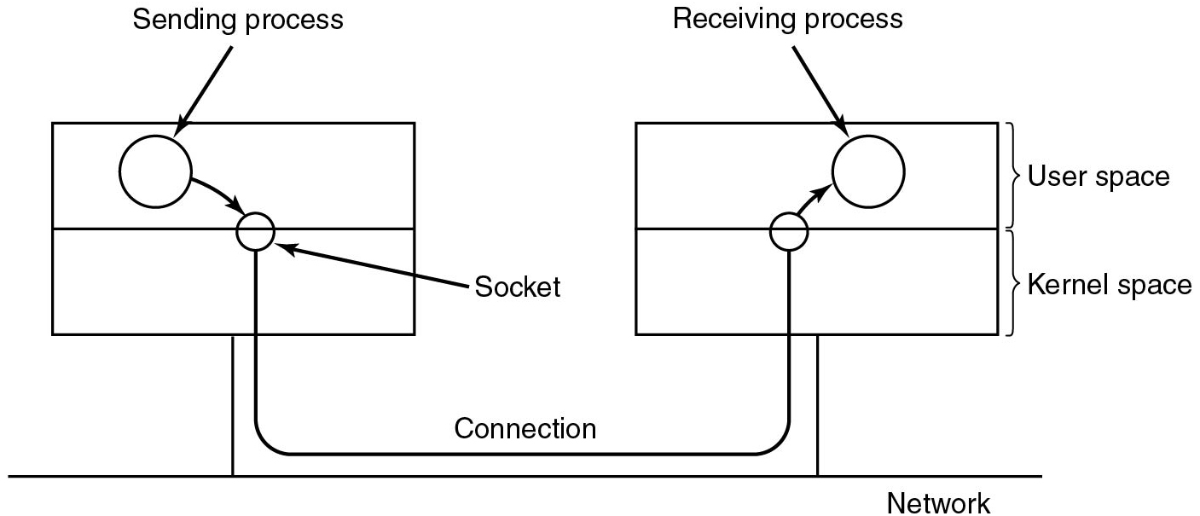
Networking (1)
Figure 10.19 The uses of sockets for networking.
Notes:
Long Description:
The figure consists of two rectangular blocks, the first block is divided into two parts, two circles are placed inside the block and labeled Sending process and Socket. An arrow is pointing from Sending process to the Socket. The second block is divided into two parts and labeled User mode and Kernel mode, two circles are placed inside the block and labeled Receiving process and Socket. An arrow is pointing from the Socket to the Receiving process. The socket circles are connected and labeled Connection. A horizontal line is connected to these two blocks and labeled Network.

Slide 28
Networking (2)
Types of networking:
Reliable connection-oriented byte stream
Reliable connection-oriented packet stream
Unreliable packet transmission

Slide 29
Input/Output System Calls in Linux
Function call | Description
s = cfsetospeed(&termios, speed) | Set the output speed
s = cfsetispeed(&termios, speed) | Set the input speed
s = cfgetospeed(&termios, speed) | Get the output speed
s = cfgtetispeed(&termios, speed) | Get the input speed
s = tcsetattr(fd, opt, &termios) | Set the attributes
s = tcgetattr(fd, &termios) | Get the attributes
Figure 10.20 The main P O S I X calls for managing the terminal.

Slide 30
The Major Device Table
Device | Open | Close | Read | Write | Ioctl | Other
Null | null | null | null | null | null | Blank
Memory | null | null | mem read | mem write | null | Blank
Keyboard | k open | k close | k read | error | k ioctl | Blank
Tty | tty open | tty close | tty read | tty write | tty ioctl | Blank
Printer | lp open | lp close | error | lp write | lp ioctl | Blank
Figure 10.21 Some of the file operations supported for typical character devices.

Slide 31
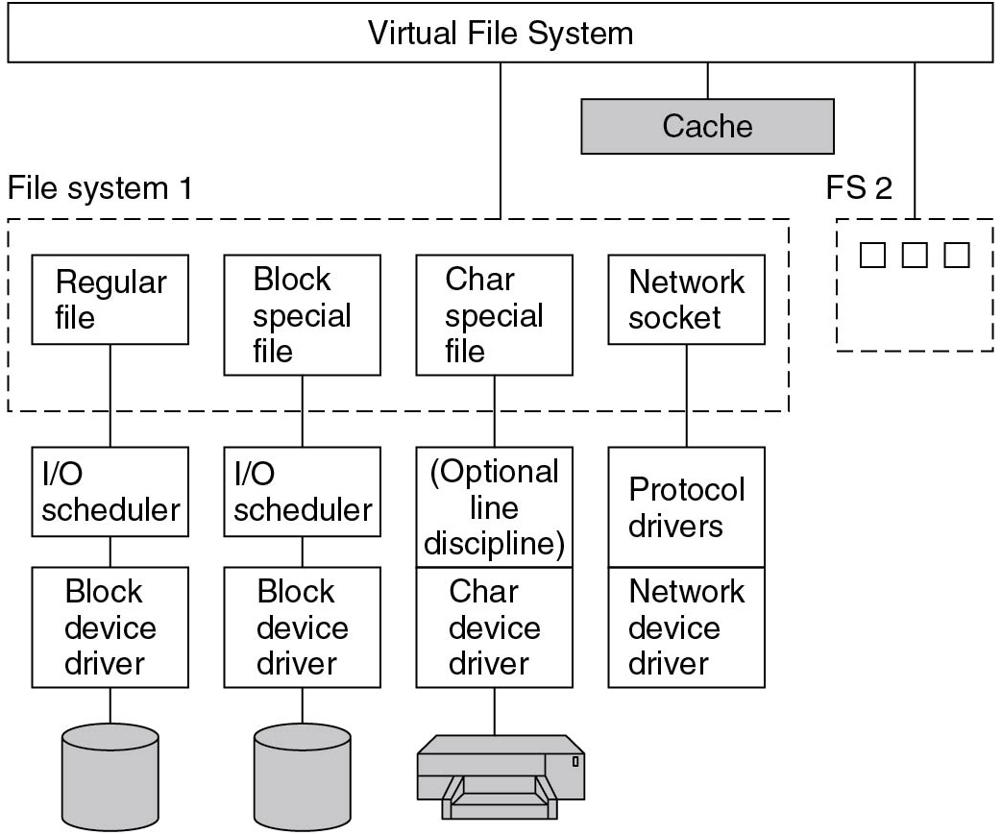
Implementation of Input/Output in Linux
Figure 10.22 The Linux I/O system showing one file system in detail.
Notes:
Long Description:
The figure consists of a rectangular block labeled Virtual File System. Three blocks are connected to the Virtual File System and labeled File system 1, Cache, and F S 2. File system 1 consists of four sub-blocks labeled Regular file, Block special file, Char special file, and Network socket. Two blocks are connected to the Regular file block and it is labeled I bar O scheduler and Block device driver. Two blocks are connected to the Block special file block and it is labeled Optional line discipline and Char device driver. Two blocks are connected to the Network socket Block labeled Protocol drivers and Network device drivers.

Slide 32
The Linux File System (1)
Directory | Contents
bin | Binary (executable) programs
dev | Special files for I/O devices
etc | Miscellaneous system files
lib | Libraries
usr | User directories
Figure 10.23 Some important directories found in most Linux systems.

Slide 33
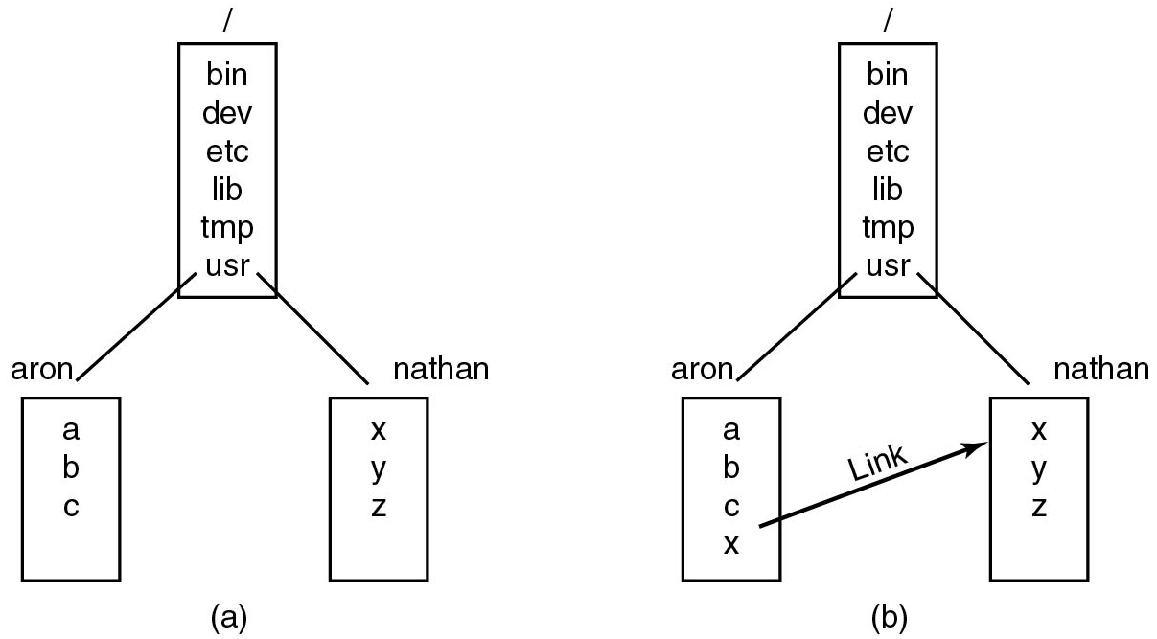
The Linux File System (2)
Figure 10.24 (a) Before linking. (b) After linking.
Notes:
Long Description:
(a): The figure shows a block labeled bin dev etc. lib tmp use, two blocks are connected to this block and labeled aron and a b c is labeled inside the block and nathan and x y z is labeled inside the block. (b): shows a block labeled bin dev etc. lib tmp use, two blocks are connected to this block and labeled aron and a b c x is labeled inside the block and nathan and x y z is labeled inside the block. An arrow labeled Link which is pointing from x to x.

Slide 34
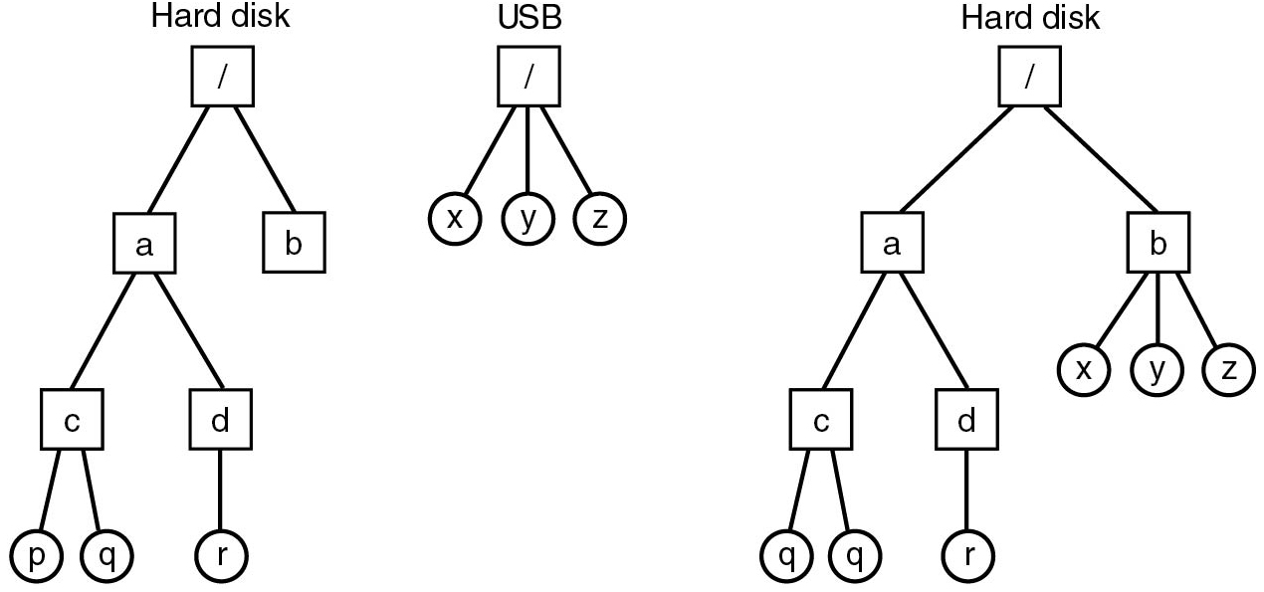
The Linux File System (3)
Figure 10.25 (a) Separate file systems. (b) After mounting.
Notes:
Long Description:
The figure shows three trees, the first tree is labeled Hard disk which is starting with a square block connected to two blocks labeled a and b. Block a is connected to two blocks labeled c and d. Block c is connected to two blocks p and q. The block d is connected to a block labeled r. The second tree is labeled U S B which is starting with a square block and is connected to three blocks labeled x, y, and z. The third tree is labeled Hard disk which is starting with a square block connected to two blocks labeled a and b. Block a is connected to two blocks labeled c and d. Block c is connected to two blocks p and q. The block d is connected to a block labeled r. The block b is connected to three blocks labeled x, y, and z.

Slide 35
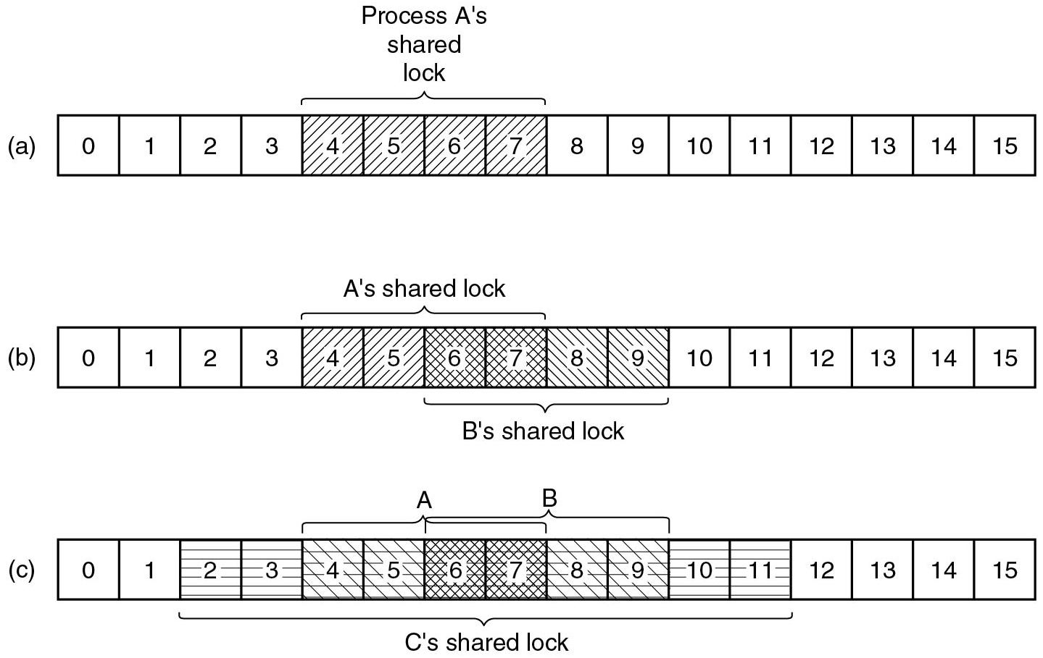
The Linux File System (4)
Figure 10.26 (a) A file with one lock. (b) Addition of a second lock. (c) A third lock.
Notes:
Long Description:
The first horizontal block is labeled 0 to 15, and 4 to 7 is labeled Process A's shared blocks which are shaded. The second horizontal block is labeled 0 to 15 and 4 to 7 is labeled A's shared block which is shaded and 6 to 9 is labeled B's shared block which is shaded. The third horizontal block is labeled 0 to 15 and 4 to 7 is labeled A and shaded, 6 to 9 is labeled B and shaded, and 2 to 11 is labeled C's shared block and shaded.

Slide 36
File System Calls in Linux (1)
System call | Description
f d = creat(name, mode) | One way to create a new file
f d = open(file, how, ...) | Open a file for reading, writing, or both
s = close(f d) | Close an open file
n = read(f d, buffer, nbytes) | Read data from a file into a buffer
n = write(f d, buffer, nbytes) | Write data from a buffer into a file
position = lseek(f d, offset, whence) | Move the file pointer
s = stat(name, &buf) | Get a file’s status information
s = fstat(f d, &buf) | Get a file’s status information
s = pipe(&f d[0]) | Create a pipe
s = fcntl(f d, cmd, ...) | File locking and other operations
Figure 10.27 System calls relating to files.

Slide 37
File System Calls in Linux (2)
Device the file is on
I-node number (which file on the device)
File mode (includes protection information)
Number of links to the file
Identity of the file’s owner
Group the file belongs to
File size (in bytes)
Creation time
Time of last access
Time of last modification
Figure 10.28 The fields returned by the stat system call.

Slide 38
File System Calls in Linux (3)
System call | Description
s = mkdir(path, mode) | Create a new directory
s = rmdir(path) | Remove a directory
s = link(oldpath, newpath) | Create a link to an existing file
s = unlink(path) | Unlink a file
s = chdir(path) | Change the working directory
dir = opendir(path) | Open a directory for reading
s = closedir(dir) | Close a directory
dirent = readdir(dir) | Read one directory entry
rewinddir(dir) | Rewind a directory so it can be reread
Figure 10.29 System calls relating to directories.

Slide 39
The Linux Virtual File System
Object | Description | Operation
Superblock | specific file-system | read inode, sync f s
Dentry | directory entry, single component of a path | create, link
I-node | specific file | d compare, d delete
File | open file associated with a process | read, write
Figure 10.30 File system abstractions supported by the V F S.

Slide 40
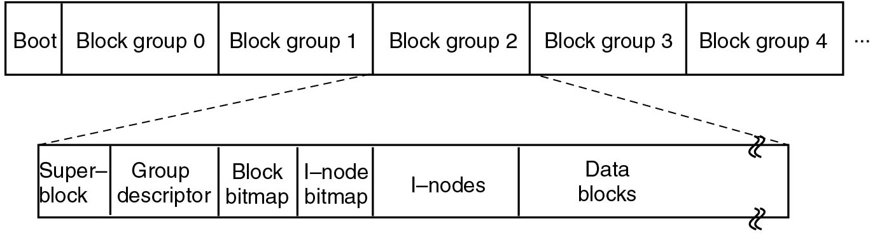
The Linux Ext2 File System (1)
Figure 10.31 Disk layout of the Linux ext2 file system.
Notes:
Long Description:
The figure shows two horizontal blocks, first horizontal block is divided into six parts and labeled Boot, Block group 0, Block group 1, Block group 2, Block group 3, and Block group 4. Block group 2 is connected to the horizontal block which is divided into six parts and labeled Superblock, Group descriptor, Block bitmap, I node bitmap, I nodes, and Data blocks.

Slide 41
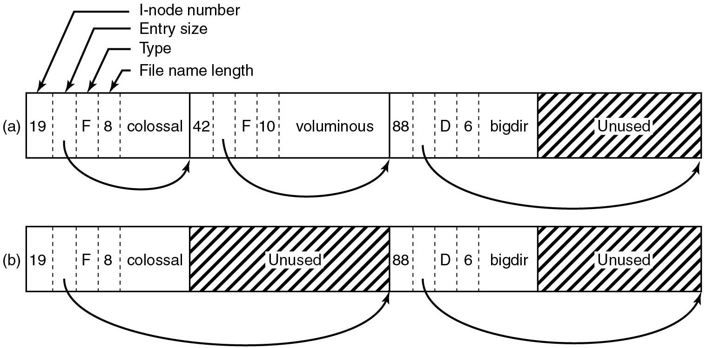
The Linux Ext2 File System (2)
Figure 10.32 (a) A Linux directory with three files. (b) The same directory after the file voluminous has been removed.
Notes:
Long Description:
The figure shows two horizontal blocks, the first horizontal block is divided into four parts, and the first part is subdivided into five parts labeled 19, blank, F, 8, and colossal. An arrow is pointed toward 19 and labeled I node number, toward blank labeled Entry size, toward F labeled Type and towards colossal labeled File name length, another arrow is pointing from blank to the end of the block. The second part is subdivided into five parts labeled 42, blank, F, 10, and voluminous, an arrow is pointing from the blank to the end of the block. The third part is subdivided into five parts labeled 88, blank, D, 6, and bigdlr. The fourth part is labeled Unused and shaded. The second horizontal block is divided into four parts, an arrow is pointing from blank to the end of the second block and the second block is labeled Unused and shaded. The third part is subdivided into five parts labeled 88, blank, D, 6, and bigdlr. The fourth part is labeled Unused and shaded. An arrows pointing from blank to the end of the fourth block.

Slide 42
The Linux Ext2 File System (3)
Field | Bytes | Description
Mode | 2 | File type, protection bits, setuid, setgid bits
Nlinks | 2 | Number of directory entr ies pointing to this i-node
U i d | 2 | U I D of the file owner
G i d | 2 | G I D of the file owner
Size | 4 | File size in bytes
Addr | 60 | Address of first 12 disk blocks, then 3 indirect blocks
Gen | 1 | Generation number (incremented every time i-node is reused)
Atime | 4 | Time the file was last accessed
Mtime | 4 | Time the file was last modified
Ctime | 4 | Time the i-node was last changed (except the other times)
Figure 10.33 Some fields in the i-node structure in Linux

Slide 43
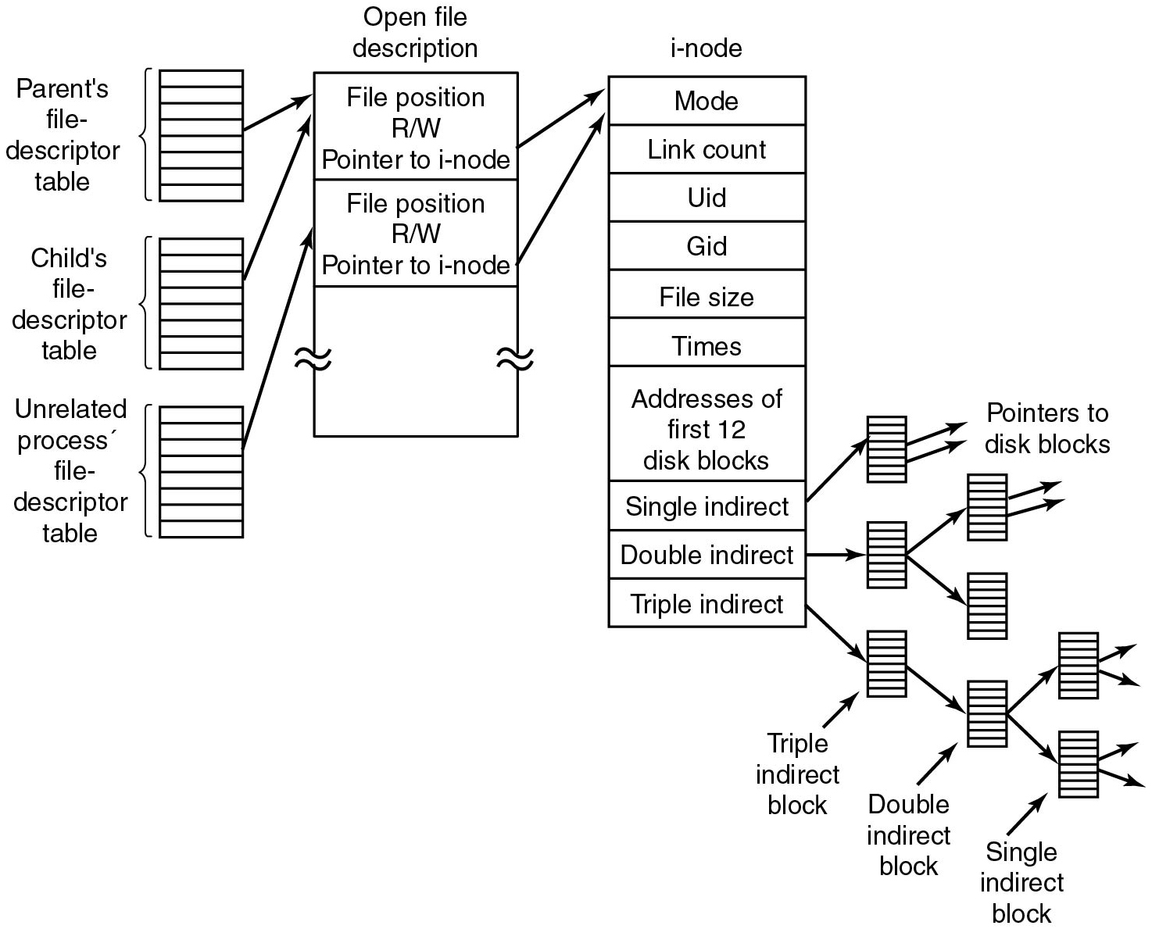
The Linux Ext2 File System (4)
Figure 10.34 The relation between the file descriptor table, the open file description table, and the i-node table.
Notes:
Long Description:
The figure shows a vertical rectangular block labeled Open file description which is divided into three parts. The first part is labeled File position R slash W Pointer to i-node, the second part is labeled File position R slash W Pointer to i-node, and the third part is blank. An arrow is pointing from an eight-segmented vertical block labeled Parent's file descriptor table to the first part of the Open file description. An arrow is pointing from an eight-segmented vertical block labeled Child's file descriptor table to the first part of the Open file description. An arrow is pointing from an eight-segmented vertical block labeled Unrelated process file descriptor table to the second part of the Open file description. A vertical block is labeled i node which is divided into ten parts labeled Mode, Link count, U i d, G i d, File size, Times, Addresses of first 12, disk blocks, Single indirect, Double indirect, and Triple indirect. An arrow is pointing from the first part of the Open file descriptor to the Mode and another arrow is pointing from the second part of the Open file descriptor to the Mode. An arrow is pointing from a Single indirect block to eight segmented blocks, two arrows are pointed from this block and labeled Pointers to disk blocks. Another arrow is pointing from a Double indirect block to eight segmented blocks, which are connected to two eight segmented blocks. Another arrow is pointing from the Triple indirect block to eight segmented blocks and an arrow is pointed towards this block and labeled Triple indirect block. The triple indirect block is connected to an eight segmented block and an arrow is pointed toward this block and labeled Double indirect block. The double indirect block is connected to an eight segmented block which is connected to two eight segmented blocks and a Single indirect block.

Slide 44
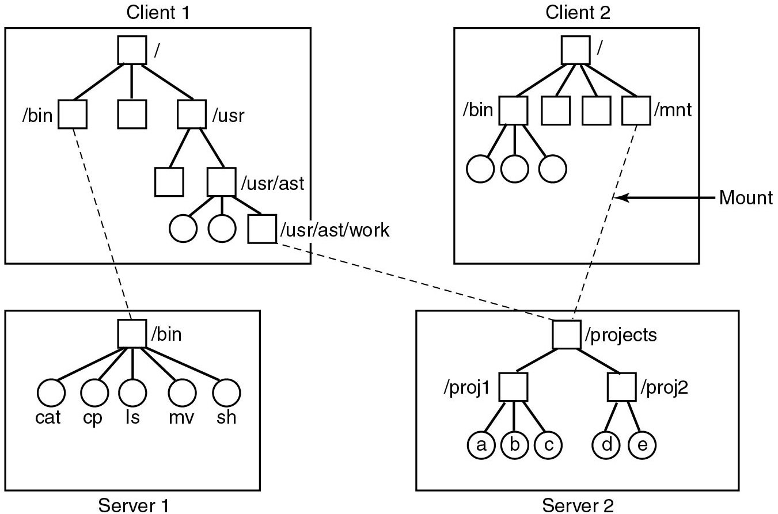
N F S Protocols
Figure 10.35 Examples of remote mounted file systems. Directories shown as squares, files shown as circles.
Notes:
Long Description:
The figure shows four square blocks labeled Client 1, Client 2, Server 1, and Server 2. Client 1 consists of a tree that starts with a square block labeled slash that is connected to three square blocks, the first block is labeled slash bin, and the third block is labeled slash usr. The slash use block is connected to two blocks, the second block is labeled slash usr slash ast, this block is connected to two circles and one square block that is labeled slash usr slash ast slash work. The Client 2 block is consist of a tree that starts with a square block labeled slash that is connected to four blocks, the first block is labeled slash bin, and the fourth block is labeled slash mnt. The slash bin block is connected to three circles. The Server 1 block is consist of a tree that starts with a square block labeled slash bin that is connected to five circles labeled cat, cp, Is, mv, and sh. The Server 2 block is consist of a tree that starts with a square block labeled slash projects that are connected to two square blocks labeled slash proj1 and slash proj2. The slash proj1 is connected to three circles labeled a,b, and C, and the slash proj2 block is connected to two circles labeled d and e. A dotted line is connected between slash mnt and slash projects and labeled Mount. Two dotted lines are connected between the slash bin of the Client 1 block and the slash bin of the Server 1 block and slash usr slash ast slash work to slash projects.

Slide 45
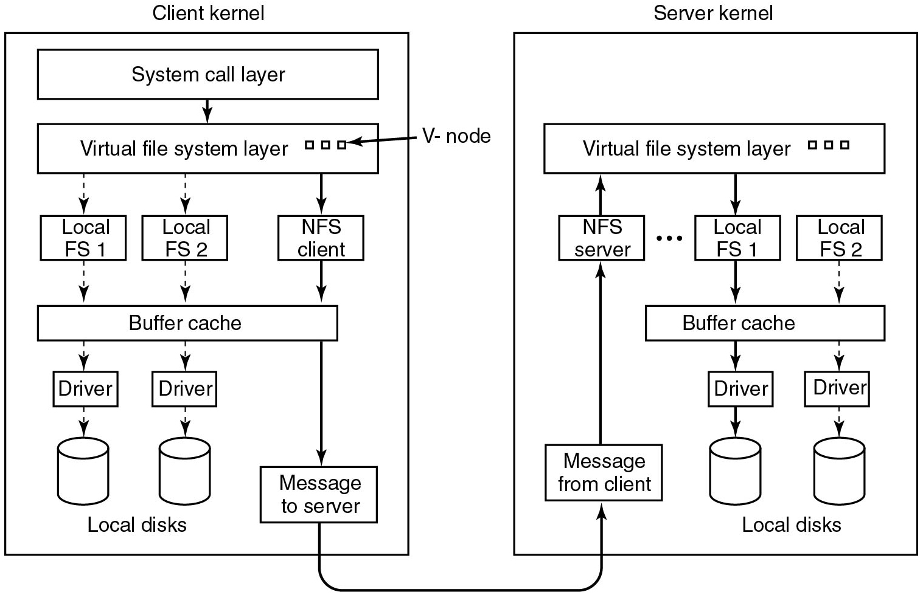
N F S Implementation
Figure 10.36 The N F S layer structure.
Notes:
Long Description:
The figure shows two rectangular vertical blocks, the first block is labeled Client kernel and the second block is labeled Server kernel. The Client kernel block consists of six layers. The first layer is a rectangular block labeled System called layer. An arrow is pointing from the first layer to the second layer and the second layer is a rectangular block which is labeled Virtual file system layer and consists of three small squares, an arrow is pointed toward these squares and labeled V node. Three arrows are pointing from the second layer to the third layer which consists of three square blocks which are labeled Local F S 1, Local F S 2, and an N F S client. Three arrows are pointed toward the fourth layer consisting of a rectangular block labeled Buffer cache. Two arrows are pointed from the fourth layer to the fifth layer consisting of two blocks labeled Driver, and another two arrows are pointed from the fifth layer to the sixth layer consisting of two cylindrical bodies labeled Local disks. An arrow points from the fifth layer to a rectangular block of the sixth layer labeled Message to server. The Server kernel block consists of five layers. the first layer is a rectangular block labeled Virtual file system layer. An arrow is pointing from the first layer to the second layer and the second layer is a rectangular block that is labeled Local F S 1 and Local F S 2. Two arrows are pointed towards the third layer consisting of a rectangular block labeled Buffer cache. Two arrows are pointed from the third layer to the fourth layer consisting of two blocks labeled Driver, and another two arrows are pointed from the fourth layer to the fifth layer consisting of two cylindrical bodies labeled Local disks. An arrow is pointing from the Message to the server block to the Message from the client block in the fifth layer of the Server kernel block. Another arrow is pointing upwards from the Server kernel block to the N F S server placed in the second layer, and another arrow points from the N F S server to the Virtual file system layer.

Slide 46
Security in Linux
Binary | Symbolic | Allowed file accesses
111000000 | rwx–––––– | Owner can read, write, and execute
111111000 | rwxrwx– – – | Owner and group can read, write, and execute
110100000 | rw–r––––– | Owner can read and write; group can read
110100100 | rw–r– –r– – | Owner can read and write; all others can read
111101101 | rwxr–xr–x | Owner can do everything, rest can read and execute
000000000 | ––––––––– | Nobody has any access
000000111 | ––––––rwx | Only outsiders have access (strange, but legal)
Figure 10.37 Some example file protection modes.

Slide 47
Security System Calls in Linux
System call | Description
s = chmod(path, mode) | Change a file’s protection mode
s = access(path, mode) | Check access using the real U I D and G I D
uid = getuid( ) | Get the real U I D
uid = geteuid( ) | Get the effective U I D
gid = getgid( ) | Get the real G I D
gid = getegid( ) | Get the effective G I D
s = chown(path, owner, group) | Change owner and group
s = setuid(uid) | Set the U I D
s = setgid(gid) | Set the G I D
Figure 10.38 System calls relating to security.

Slide 48

ANDROID
Aakashraja/123 R F
Android is not really an operating system, but a software layer that runs on top of Linux.

Slide 49
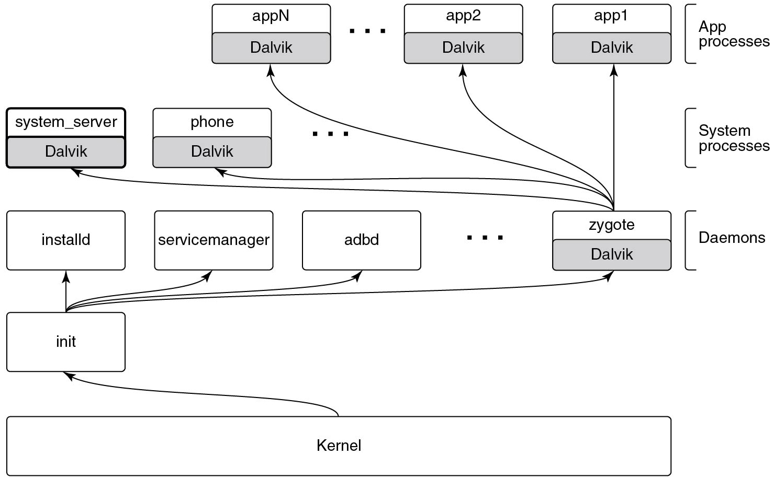
Android System Architecture
Figure 10.39 Android process hierarchy
Notes:
Long Description:
The figure consists of five layers. The first layer is labeled App processes which consists of three rectangular blocks, the first block is divided into two parts labeled app N and Dalvik, the second block is divided into two parts labeled app2 and Dalvik, and the third block is divided into two parts labeled app1 and Dalvik. The second layer is labeled System processes which consists of two rectangular blocks, the first block is divided into two parts labeled system server and Dalvik, and the second block is divided into two parts labeled phone and Dalvik. The third layer is labeled Daemons which consists of three rectangular blocks, the first block is labeled installed, the second block is labeled service manager, the third block is labeled a d b d and the fourth block is divided into two parts labeled zygote and Dalvik. All Dalvik blocks are shaded. Five arrows are pointing from zygote block to all these Dalvik blocks. The fourth layer is consist of a rectangular block which is labeled ini t, four arrows are pointing from ini t block to the four blocks in the third layer. The fifth layer is consist of a rectangular block which is labeled Kernel, an arrow is pointing from the Kernel block to the ini t block.

Slide 50
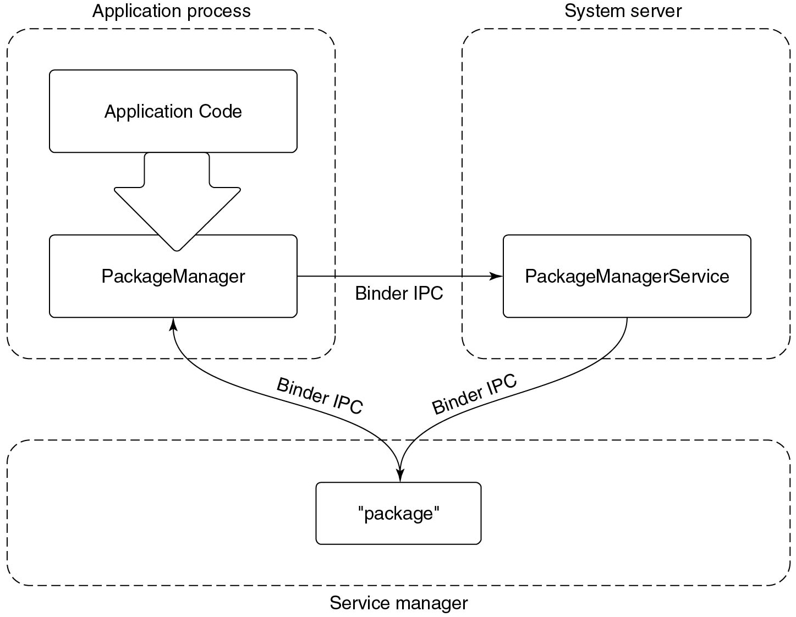
Packages
Figure 10.40 Publishing and interacting with system services.
Notes:
Long Description:
The figure shows three rectangular blocks, the first block is labeled Application process which is subdivided into two rectangular Application Code and PackageManager. The second block is labeled System server and it consists of a sub-block labeled PackageManagerService. An arrow is pointing from PackageManager to the PackageManagerService which is labeled Binder I P C. The third horizontal block is labeled Service manager and it consists of a sub-block labeled package. An arrow is pointing from PackageManager to the Package which is labeled Binder I P C, and another arrow is pointing from PackageManagerService to the Package which is labeled Binder I P C.

Slide 51
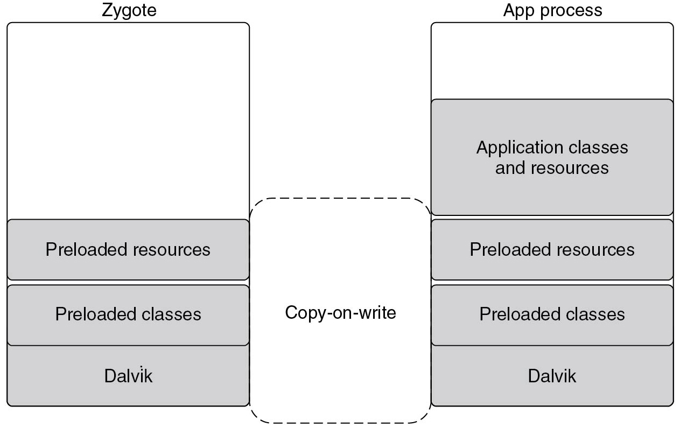
Android Run Time (A R T)
Figure 10.41 Creating a new A R T process from zygote.
Notes:
Long Description:
The figure shows two rectangular vertical blocks, the first block is titled Zygote which is divided into three parts labeled Preloaded resources, Preloaded classes, and Dalvik at the lower part of the block. The second block is labeled App process which is divided into four parts labeled Application classes and resources, Preloaded resources, Preloaded classes, and Dalvik. These two vertical blocks are connected by a dotted line labeled Copy on write.

Slide 52
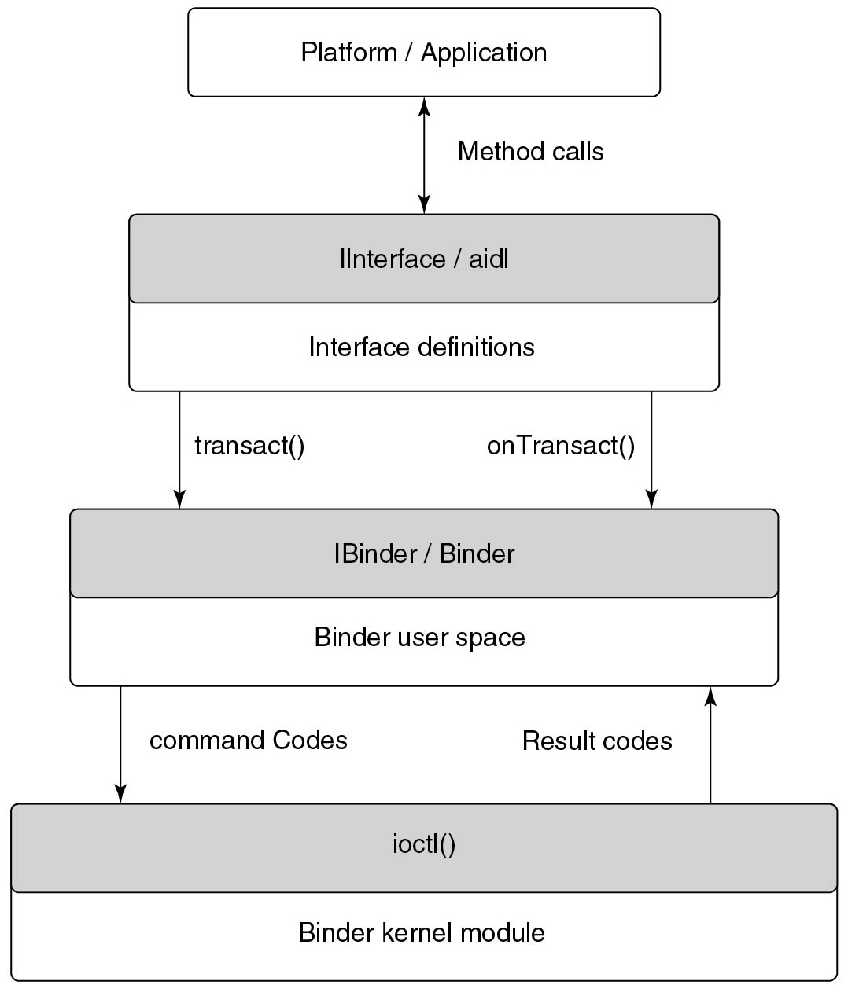
Binder Kernel Module
Figure 10.42 Binder I P C architecture.
Notes:
Long Description:
The figure consists of four layers. The first layer has a rectangular block that is labeled Platform or Application. The second layer has a rectangular block which is divided into two parts and labeled Interface or a i d l and Interface definitions. A two-sided arrow is connected between the first and second block and labeled Method calls. The third layer has a rectangular block that is divided into two parts and labeled IBinder or Binder and Binder user space, two one-sided arrows are connected second and third layers and labeled transact() and on transact(). The fourth layer has a rectangular block which is divided into two parts and labeled i o c t l() and Binder kernel module, two one-sided arrows are connected third and fourth layers and labeled command Codes and Result codes.

Slide 53
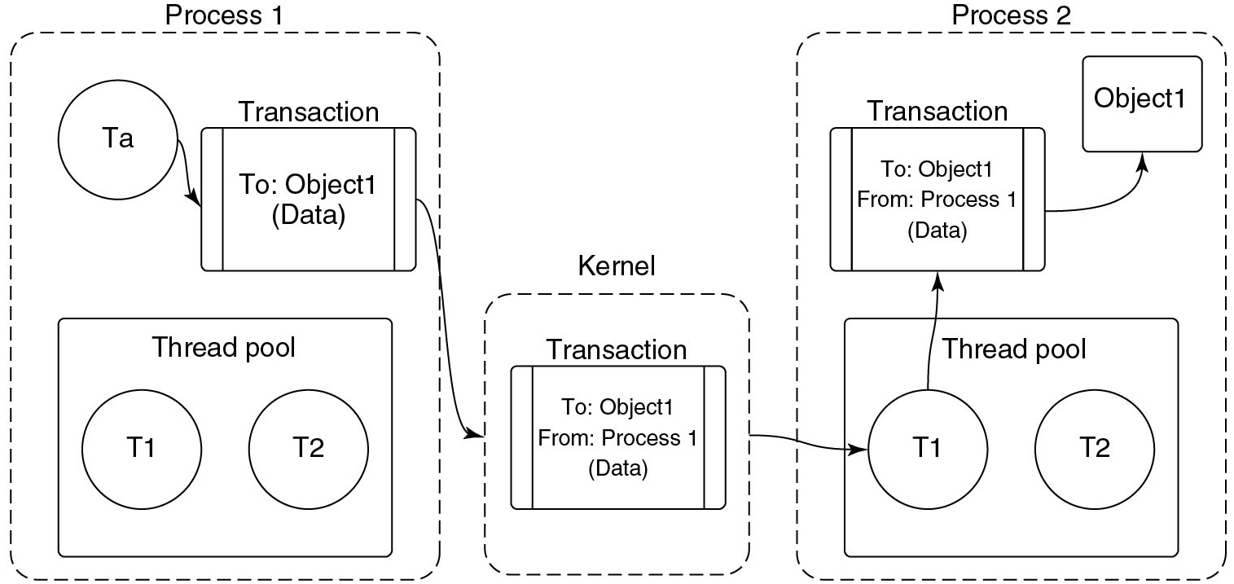
Binder Transactions
Figure 10.43 Basic Binder I P C transaction
Notes:
Long Description:
The figure consist of three vertical rectangular blocks labeled Process 1, Kernel, and Process 2. Process 1 block consists of one circle and two rectangular blocks. The circle is labeled T a and the rectangular block is labeled Transaction, inside the rectangular block is labeled To: Object1 (Data). An arrow is pointing from the circle to the Transaction block. The second rectangular block is labeled Thread pool and it consists of two circles labeled T1 and T2. Kernel block is consist of a rectangular block labeled Transaction and inside the block is labeled To: Object1 From: Process 1 (Data). An arrow points from the Transaction block of the Process block to the Transaction block of the Kernel block. Process 2 block is consist of three rectangular blocks, the first block is labeled Object 1, the second block is labeled Transaction and inside the block is labeled To: Object1 From: Process 1 (Data), and the third block is labeled Thread pool and it consists of two circles labeled T1 and T2. An arrow is pointing from the Kernel block to the Thread pool of the Process 2 block, another arrow is pointing from the T1 to the Transaction block of the Process 2 block. Another arrow is pointing from the Transaction Block to the Object block.

Slide 54
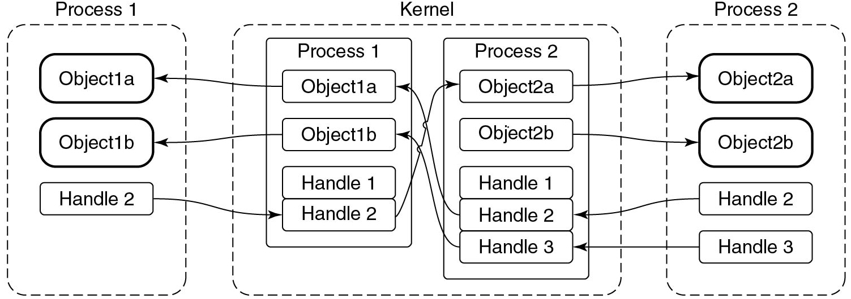
Cross Process Transactions
Figure 10.44 Binder cross-process object mapping.
Notes:
Long Description:
The figure consist of three vertical rectangular blocks labeled Process 1, Kernel, and Process 2. Process 1 block consist of three rectangular blocks labeled Object 1a, Object 1b, and Handle 2. Kernel block consist of two rectangular blocks labeled Process 1 and Process 2. Process 1 block consist of four rectangular blocks labeled Object 1a, Object 1b, Handle 1, and Handle 2. Process 2 block consists of five rectangular blocks labeled Object2a, Object2b, Handle 1, Handle 2, and Handle 3. Process 2 block consists of four rectangular blocks labeled Object2a, Object2b, Handle 2, and Handle 3. An arrow is pointing from Object 1a of Process 1 in the Kernel block to the Object 1a of the Process 1 block. An arrow is pointing from Object 1b of Process 1 in the Kernel block to Object 1b of the Process 1 block. An arrow is pointing from Handle 2 of the Process 1 block to the Handle 2 of the Process 1 in the Kernel block. Three arrows are connected between Process 1 and Process 2 of the Kernel block, an arrow is pointing from Handle 2 to Object2a, Handle 2 to Object 1a, and Handle 3 to Object 1b. Two arrows are connected from Process 2 of the kernel block to the Process 2 block which is pointing from Object2a to Object2a and Object2b to Object2b. Two arrows are connected from the Process 2 block to the Process 2 of the Kernel block which is pointing from Handle 2 to Handle 2 and Handle 3 to Handle 3.

Slide 55
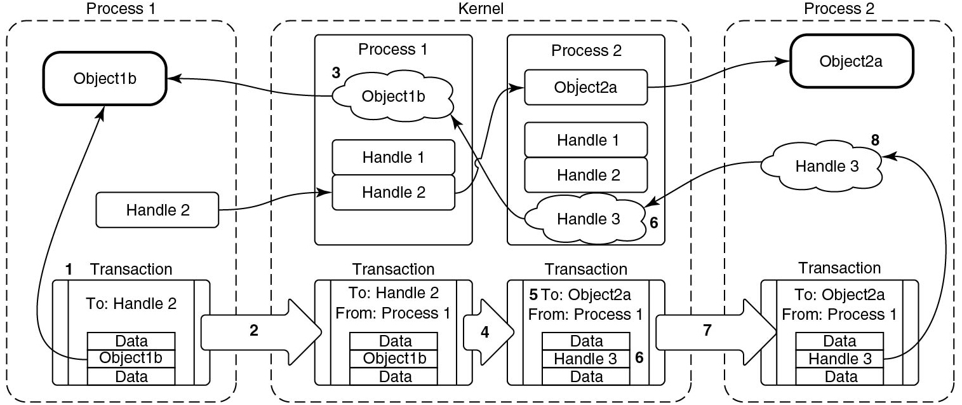
Transferring Binder Objects
Figure 10.45 Transferring Binder objects between processes.
Notes:
Long Description:
The figure consists of three vertical rectangular blocks labeled Process 1, Kernel, and Process 2. Process 1 block consist of Three rectangular blocks labeled Object 1b, Handle 2, and Transaction inside the block is labeled To: Handle 2 and also consist of a rectangular block which is divided into three parts and labeled Data, Object 1b, and Data. Kernel block consist of four rectangular blocks labeled Process 1, Process 2, Transaction, and Transaction. Process 1 block consists of three rectangular blocks labeled Object 1b, Handle 1, and Handle 2. Process 2 block consists of four rectangular blocks labeled Object2a, Handle 1, Handle 2, and Handle 3. Transaction inside the block is labeled To: Handle 2 From: Process 1 and also consists of a rectangular block which is divided into three parts and labeled Data, Object 1b, and Data. Transaction inside the block is labeled To: Object 2a From: Process 1 and also consists of a rectangular block which is divided into three parts and labeled Data, Handle 3, and Data. Process 2 block consist of three rectangular blocks labeled Object2a, Handle 3, and Transaction inside the block are labeled To: Object 2a From: Process 1 and also consists of a rectangular block which is divided into three parts and labeled Data, Handle 3, and Data. There are 11 arrows are marked in this figure, the first arrow is pointing from Object 1b of the Transaction block to the Object 1b block in Process 1 block, the second arrow is pointing from Handle 2 of the Process 1 block to the Handle 2 of process 1 in Kernel bock, the third arrow is pointing from Object 1b of the Kernel block to theObject1b of the Process 1 block, the fourth arrow is pointing from Handle 2 to the Object2a in kernel block and fifth arrow is pointing from Handle 3 to the Object 1b in Kernel block. The sixth arrow is pointing from Handle 3 of the Transaction block in the Process 2 block to the Handle 3 block in the Process 2 block. The seventh arrow is pointing from the Handle 3 of the Process 2 block to the Handle 3 in the Kernel block. The eighth arrow is pointing from Object2a of the Kernel block to the Object2a of the Process 2 block.

Slide 56
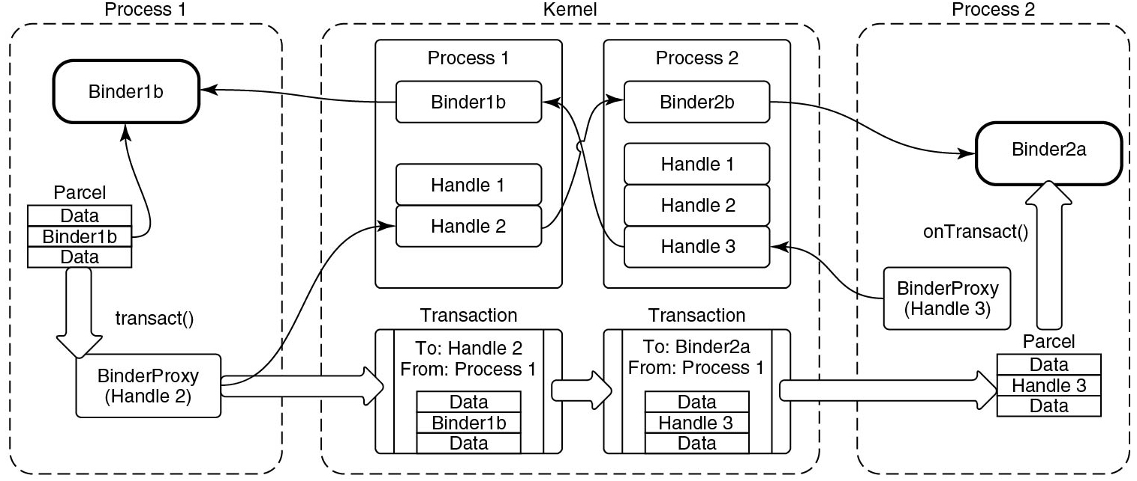
Binder User-Space A P I
Figure 10.46 Binder user-space A P I.
Notes:
Long Description:
The figure consist of three vertical rectangular blocks labeled Process 1, Kernel, and Process 2. Process 1 block consist of Three rectangular blocks labeled Binder 1b, Parcel, and BinderProxy(Handle 2). The parcel block is divided into three parts Data, Binder 1b, and Data. An arrow is pointing from the Parcel block to the BinderProxy. Kernel blocks consist of four rectangular blocks labeled Process 1, Process 2, Transaction, and Transaction. Process 1 block consists of three rectangular blocks labeled Binder 1b, Handle 1, and Handle 2. Process 2 block consists of four rectangular blocks labeled Binder2b, Handle 1, Handle 2, and Handle 3. Transaction inside the block is labeled To Handle 2 From: Process 1 and also consist of a rectangular block which is divided into three parts and labeled Data, Binder 1b, and Data. Transaction inside the block is labeled To: Object 2a From: Process 1 and also consists of a rectangular block which is divided into three parts and labeled Data, Handle3, and Data. An arrow is pointing from BinderProxy to the Transaction block. Another arrow is connected between two Transaction blocks. Process 2 block consists of Three rectangular blocks labeled Binder2a, Parcel, and BinderProxy(Handle 3). The parcel block is divided into three parts Data, Handle 3, and Data. An arrow is pointing from the Parcel block to the Binder2a. Another arrow is pointing from the Transaction block to the Parcel block of the Process 2 block.

Slide 57
Example Package Interface
package com.example
interface IExample {
void print(Str ing msg);
}
Figure 10.47 Simple interface described in A I D L.

Slide 58
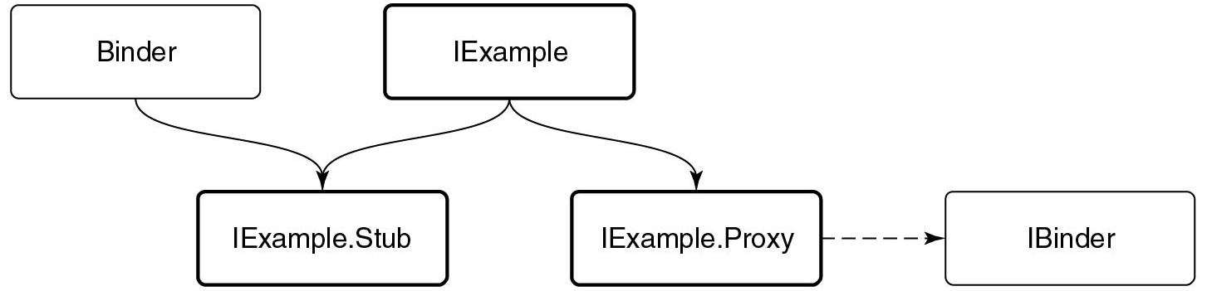
Binder Inheritance
Figure 10.48 Binder interface inheritance hierarchy.
Notes:
Long Description:
The figure shows two layers which consist of five rectangular blocks, the first layer consist of two rectangular blocks labeled Binder and Iexample. The second layer consists of three rectangular blocks labeled IExample.Stub, IExample.Proxy and IBinder. Two arrows are pointing from Binder and Iexample block to the IExample.Stub block. Another arrow is pointing IExample block to IExample.Proxy. A dotted arrow is pointing from IExample.Proxy to the IBinder.

Slide 59
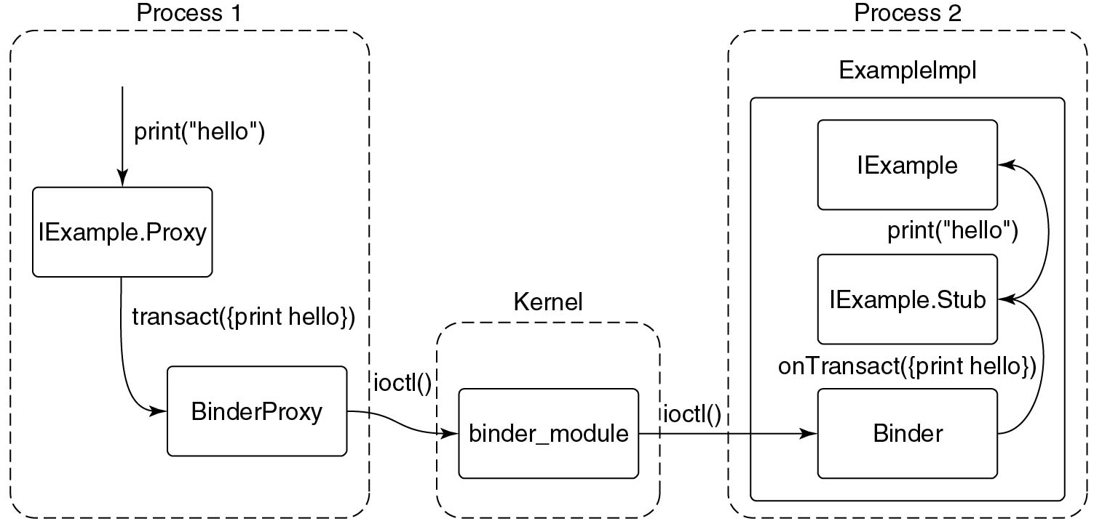
A I D L-Based Binder I P C
Figure 10.49 Full path of an A I D L-based Binder I P C.
Notes:
Long Description:
The figure shows three dotted rectangular blocks labeled Process 1, Kernel, and Process 2. The Process 1 block is subdivided into two blocks labeled IExample.Proxy and BinderProxy. A one sided arrow is pointed towards IExample.Proxy, labeled print open parenthesis open double quote hello close double quote close parenthesis, and another arrow are pointing from IExample.Proxy to the BinderProxy, labeled transact open parenthesis open string bracket print hello close string bracket close parenthesis. The kernel block is consist of a sub block which is labeled binder module, a one sided arrow is pointing from BinderProxy to the binder module which is labeled i o c t l open parenthesis close parenthesis. The Process 2 block consists of a rectangular block which is labeled Example M p l which is again subdivided into three sub blocks and labeled IExample, IExample.Stub, and Binder. A one sided arrow is pointing from binder module to the Binder which is labeled i o c t l open parenthesis close parenthesis. Another one sided arrow is pointing from Binder to the IExample.Stub block, which is labeled onTransact open parenthesis open string print hello close string bracket close parenthesis. Another one sided arrow is pointing from IExample.Stub block to the IExample which is labeled print open parenthesis open double quote hello close double quote close parenthesis.

Slide 60
Service Manager
package android.o s
interface IServiceManager {
IBinder getService(Str ing name);
void addService(Str ing name, IBinder binder);
}
Figure 10.50 Basic service manager A I D L interface.

Slide 61
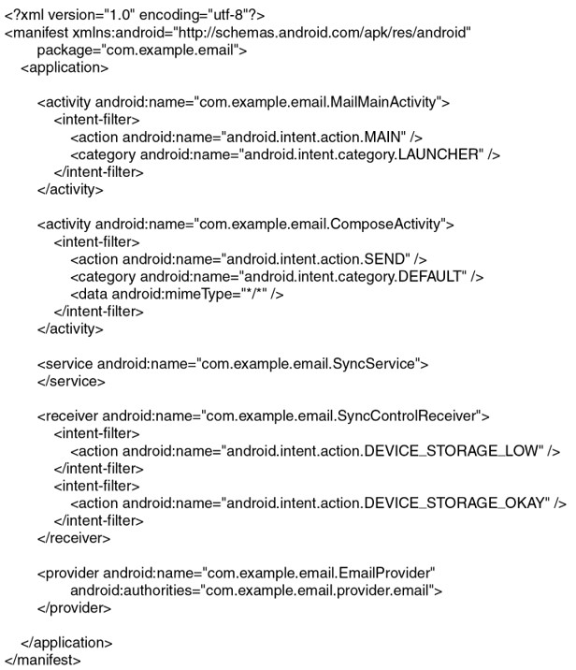
Android Manifest
Figure 10.51 Basic structure of AndroidManifest.xml.
Notes:
Long Description:
open angle bracket question mark xml version equals double quote 1 dot 0 double quote encoding equals double quote u t f dash 8 double quote question mark close angle bracket open angle bracket manifest x m l n s colon android equals double quote http colon forward slash forward slash schemas dot android dot com forward slash a p k forward slash res forward slash android double quote
package equals double quote com dot example dot email double quote close angle bracket open angle bracket application close angle bracket
open angle bracket activity android colon name equals double quote com dot example dot email dot Mail MainActivity double quote close angle bracket open angle bracket intent dash filter close angle bracket open angle bracket action android colon name equals double quote android dot intent dot action dot MAIN double quote forward slash close angle bracket open angle bracket category android colon name equals double quote android dot intent dot category dot LAUNCHER double quote forward slash close angle bracket open angle bracket forward slash intent dash filter close angle bracket open angle bracket forward slash activity close angle bracket open angle bracket activity android colon name equals double quote com dot example dot email dot Compose Activity double quote close angle bracket open angle bracket intent dash filter close angle bracket open angle bracket action android colon name equals double quote android dot intent dot action dot SEND double quote forward slash close angle bracket open angle bracket category android colon name equals double quote android dot intent dot category dot DEFAULT double quote forward slash close angle bracket open angle bracket data android colon mime Type equals double quote asterisk forward slash asterisk double quote forward slash close angle bracket open angle bracket forward slash intent dash filter close angle bracket open angle bracket forward slash activity close angle bracket open angle bracket service android colon name equals double quote com dot example dot email dot SyncService double quote close angle bracket open angle bracket forward slash service close angle bracket open angle bracket receiver android colon name equals double quote com dot example dot email dot SyncControlReceiver double quote close angle bracket open angle bracket intent dash filter close angle bracket open angle bracket action android colon name equals double quote android dot intent dot action dot DEVICE underscore STORAGE underscore LOW double quote forward slash close angle bracket open angle bracket forward slash intent dash filter close angle bracket open angle bracket intent dash filter close angle bracket open angle bracket action android colon name equals double quote android dot intent dot action dot DEVICE underscore STORAGE underscore OKAY double quote forward slash close angle bracket open angle bracket forward slash intent dash filter close angle bracket open angle bracket forward slash receiver close angle bracket open angle bracket provider android colon name equals double quote com dot example dot email dot EmailProvider double quote android colon authorities equals double quote com dot example dot email dot provider dot email double quote close angle bracket open angle bracket forward slash provider close angle bracket open angle bracket forward slash application close angle bracket open angle bracket forward slash manifest close angle bracket

Slide 62
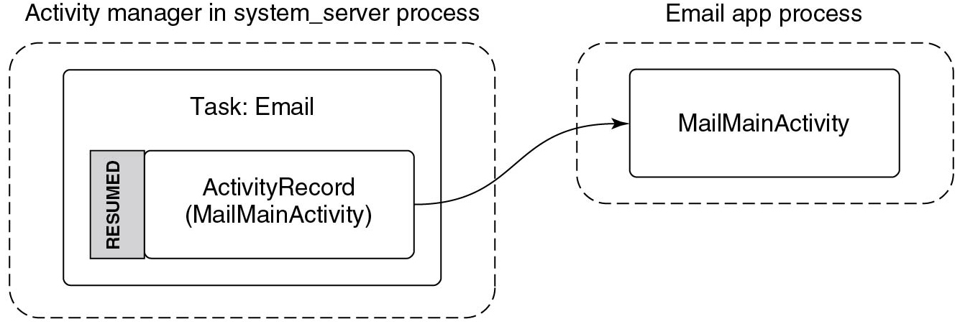
Activities
Figure 10.52 Starting an email application’s main activity.
Notes:
Long Description:
The figure shows two dotted rectangular blocks labeled Activity manager in system server process and Email app process. The first block consist of a rectangular block labeled Task: Email which again consists of another rectangular block divided into two parts that are labeled RESUMED and ActivityRecord (Mail MainActivity). The second block consist of a rectangular block labeled Mail MainActivity. An arrow is pointing from ActivityRecord (Mail MainActivity) to the Mail MainActivity block.

Slide 63
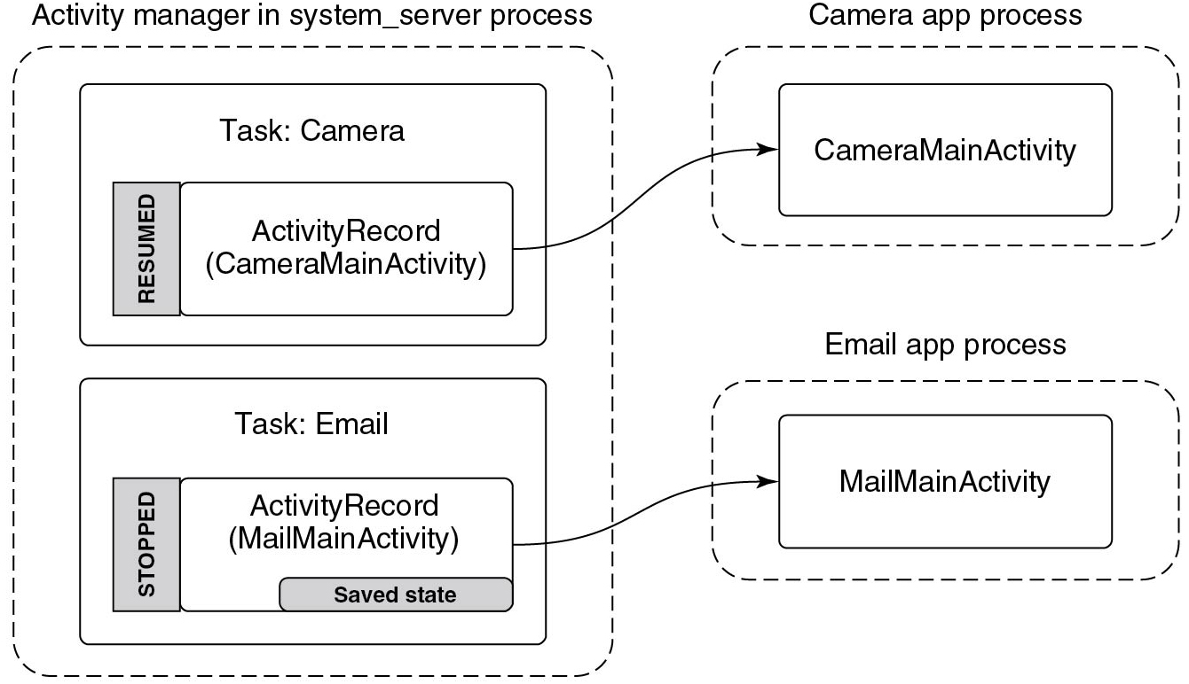
Starting Another Activity
Figure 10.53 Starting the camera application after email.
Notes:
Long Description:
The figure shows three dotted rectangular blocks labeled Activity manager in system server process, Camera app process, and Email app process. The first block consist of two rectangular blocks labeled Task: Camera and Task: Email. Task: Camera again consist of another rectangular block divided into two parts that are labeled RESUMED which is shaded and ActivityRecord (Camera MainActivity). Task: Email consists of another rectangular block divided into two parts that are labeled STOPPED which is shaded and ActivityRecord (Mail MainActivity) and Saved state which is shaded. The second block consist of a rectangular block labeled Camera app process which consists of another rectangular block labeled CameraMainActivity. An arrow is pointing from ActivityRecord (Camera MainActivity) to CameraMainActivity. The third block consist of a rectangular block labeled Email app process which consists of another rectangular block labeled Mail MainActivity. An arrow is pointing from ActivityRecord (Mail MainActivity) to Mail MainActivity.

Slide 64
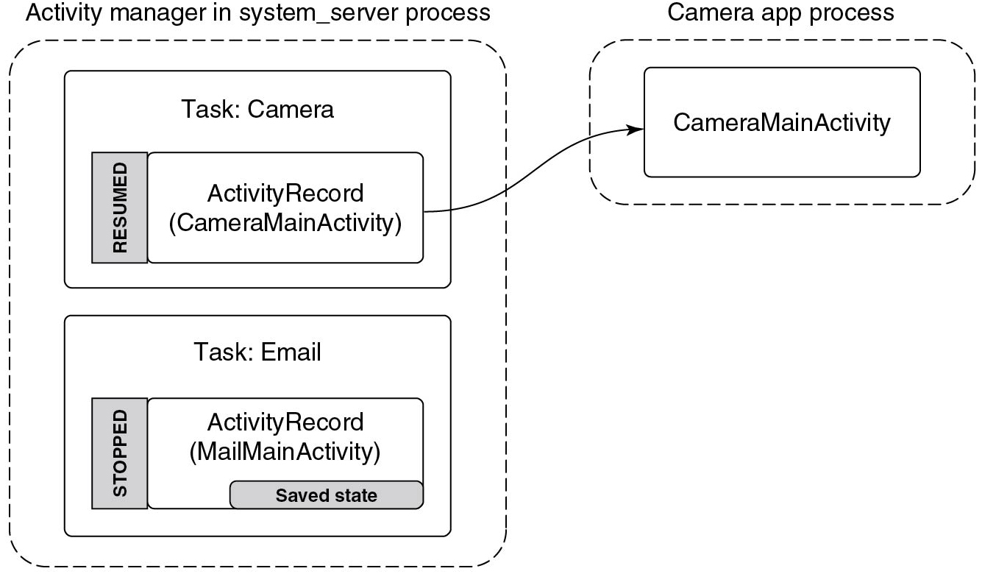
Reclaiming RAM
Figure 10.54 Removing the email process to reclaim R A M for the camera.
Notes:
Long Description:
The figure shows two dotted rectangular blocks labeled Activity manager in system server process and Camera app process. The first block consist of two rectangular blocks labeled Task: Camera and Task: Email. Task: Camera again consist of another rectangular block divided into two parts that are labeled RESUMED which is shaded and ActivityRecord (Camera MainActivity). Task: Email consists of another rectangular block divided into two parts that are labeled STOPPED which is shaded and ActivityRecord (Mail MainActivity) and Saved state which is shaded. The second block consist of a rectangular block labeled Camera app process which consists of another rectangular block labeled CameraMainActivity. An arrow is pointing from ActivityRecord (Camera MainActivity) to CameraMainActivity.

Slide 65
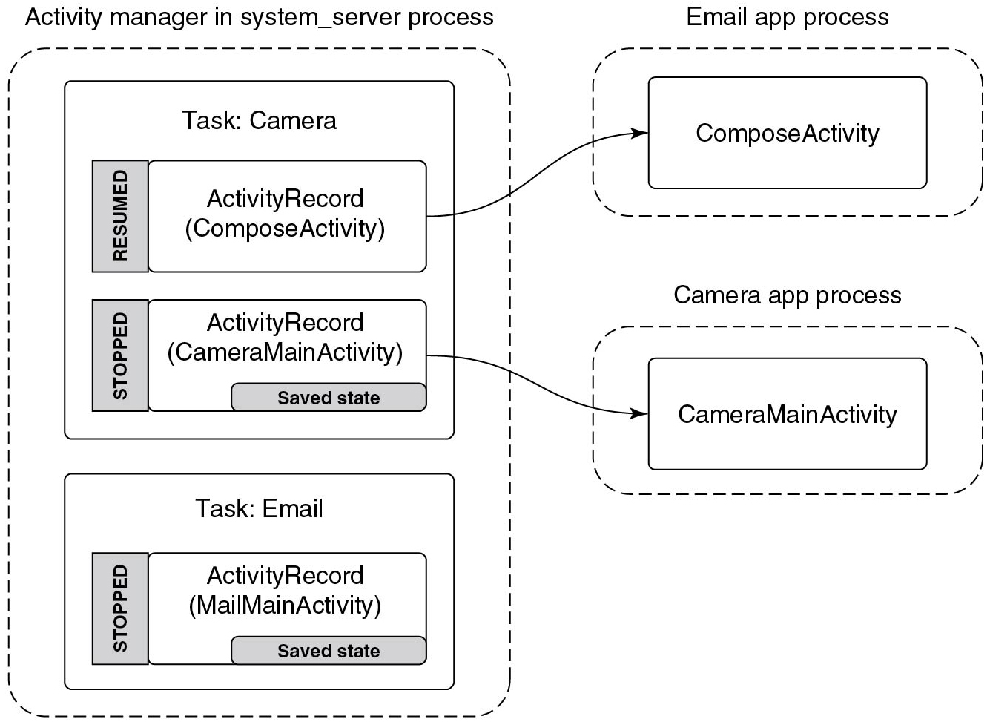
Sharing Data between Applications
Figure 10.55 Sharing a camera picture through the email application.
Notes:
Long Description:
The figure shows three dotted rectangular blocks labeled Activity manager in system server process, Camera app process, and Email app process. The first block consist of two rectangular blocks labeled Task: Camera and Task: Email. Task: Camera again consist of another two rectangular blocks, the first block is divided into two parts that are labeled RESUMED which is shaded, and ActivityRecord (Compose Activity), and the second block is divided into two parts that are labeled STOPPED which is shaded and ActivityRecord (Camera MainActivity) and Saved state which is shaded. Task: Email consists of another rectangular block divided into two parts that are labeled STOPPED which is shaded and ActivityRecord (Camera MainActivity) and Saved state which is shaded. The second block consist of a rectangular block labeled Camera app process which consists of another rectangular block labeled CameraMainActivity. An arrow is pointing from ActivityRecord (Mail MainActivity) to CameraMainActivity. The third block consist of a rectangular block labeled Email app process which consists of another rectangular block labeled Compose Activity. An arrow is pointing from ActivityRecord (Compose Activity) to Compose Activity.

Slide 66
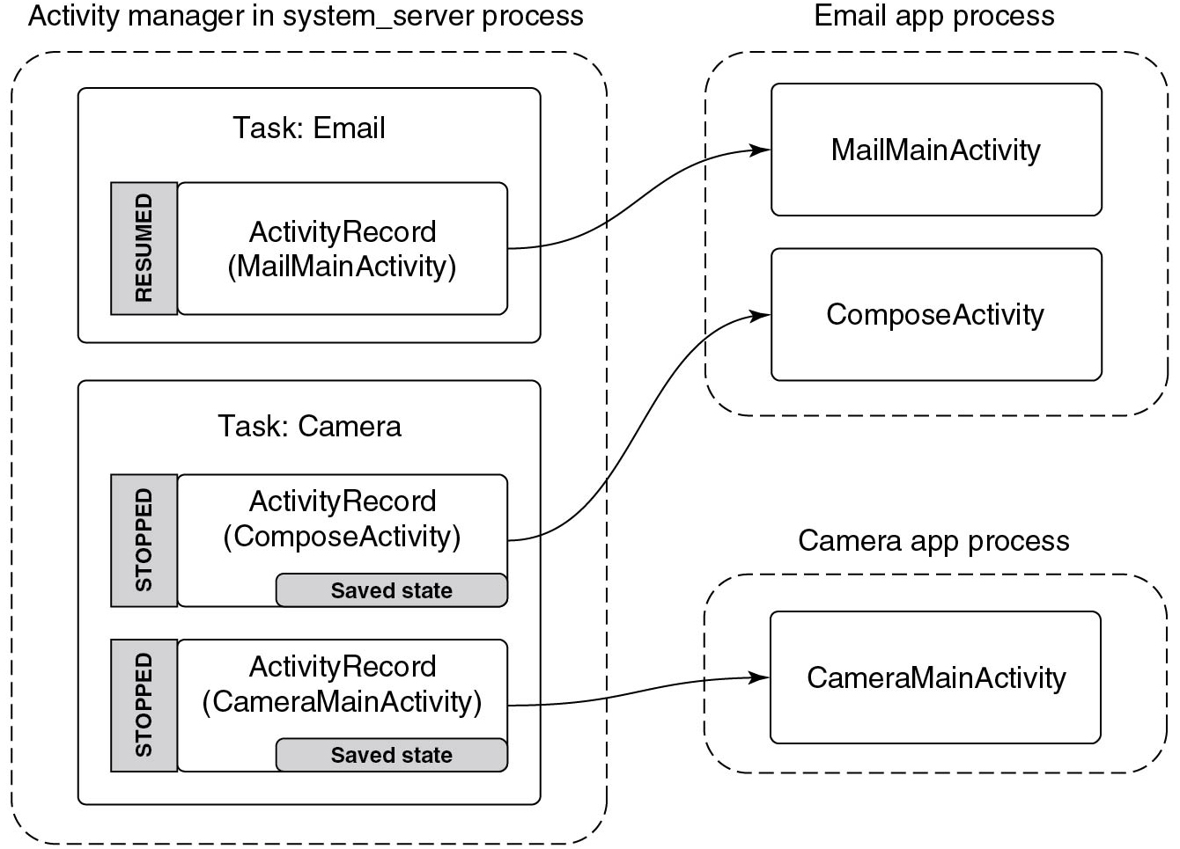
Going Back to the Email Application
Figure 10.56 Returning to the email application.
Notes:
Long Description:
The figure shows three dotted rectangular blocks labeled Activity manager in system server process, Camera app process, and Email app process. The first block consist of two rectangular blocks labeled Task: Camera and Task: Email. Task: Email consists of another rectangular block divided into two parts that are labeled RESUMED which is shaded and ActivityRecord (Mail MainActivity). Task: Camera again consist of another two rectangular blocks, the first block is divided into two parts that are labeled STOPPED which is shaded, and ActivityRecord (Compose Activity) and Saved state which is shaded and the second block is divided into two parts that are labeled STOPPED which is shaded and ActivityRecord (Camera Main Activity) and Saved state which is shaded. The second block consists of a rectangular block labeled Email app process which consists of another two rectangular blocks labeled Mail MainActivity and Compose Activity. An arrow is pointing from ActivityRecord (Mail MainActivity) of the Task: Email to CameraMainActivity to Mail MainActivity of Email app process. The third block consist of a rectangular block labeled Camera app process which consists of another rectangular block labeled CameraMainActivity. An arrow is pointing from ActivityRecord (Compose Activity) of the first part of the Task: Camera to ComposeActivity of Email app process and another arrow is pointing from ActivityRecord (CameraMainActivity) to CameraMainActivity of Camera app process.

Slide 67
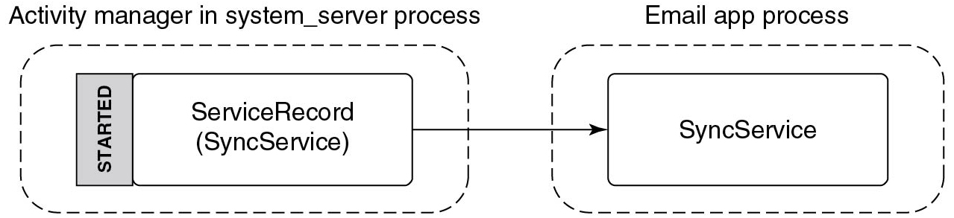
Application Services
Figure 10.57 Starting an application service
Notes:
Long Description:
The figure shows two dotted rectangular blocks labeled Activity manager in system server process and Email app process. The first block consists of a rectangular block that is divided into two parts and labeled STARTED and ServiceRecord(SyncService). The second block consists of a rectangular block which is labeled SyncService. An arrow is pointing from ServiceRecord(SyncService) to SyncService.

Slide 68
Sync Service Example
package com.example.email
interface ISyncControl {
int getSyncInterval();
void setSyncInterval(int seconds);
}
Figure 10.58 Interface for controlling a sync service’s sync interval.

Slide 69
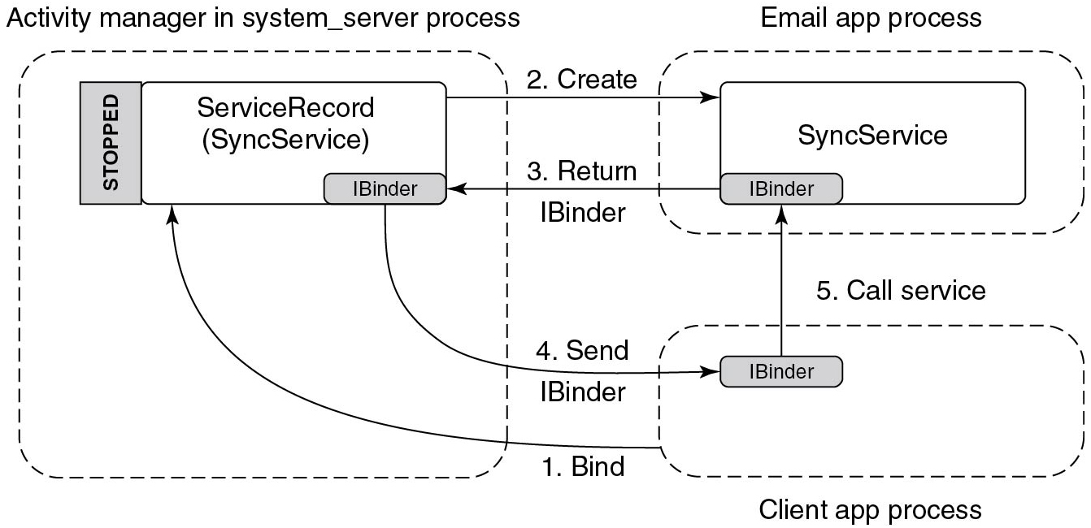
Binding to a Service
Figure 10.59 Binding to an application service.
Notes:
Long Description:
The figure shows three dotted rectangular blocks labeled Activity manager in system server process, Email app process, and Client app process. The activity manager in the system server process consists of a rectangular block that is divided into three parts labeled STOPPED, ServiceRecord(SyncService), and IBinder. The email app process consists of a rectangular block that is divided into two parts labeled SyncService and IBinder. The client app process consists of a rectangular block labeled IBinder. The figure shows five arrows, the first arrow labeled 1. Bind is pointing from the Client app process to ServiceRecord. The second arrow labeled 2. Create is pointing from ServiceRecord to SyncService. The third arrow labeled 3. Return is pointing from IBinder of the SyncService to IBinder of the ServiceRecord. The fourth arrow labeled 4. Send is pointing from IBinder of the ServiceRecord to IBinder of the Client app process. The fifth arrow labeled 5. Call service is pointing from IBinder of the Client app process to IBinder of the sync service.

Slide 70
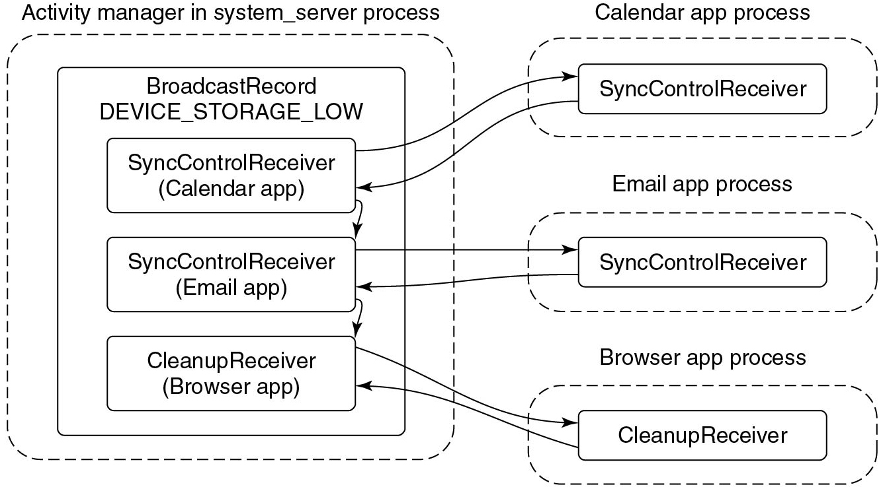
Broadcasting
Figure 10.60 Sending a broadcast to application receivers
Notes:
Long Description:
The figure shows four rectangular dotted blocks labeled Activity manager in the system server process, calendar app process, Email app process, and Browser app process. The first block consists of another rectangular block which is labeled BroadcastRecord Device underscore Storage underscore Low. It consists of three rectangular blocks labeled SyncControlReceiver (Calendar app), SyncControlReceiver (Email app), and CleanupReceiver (Browser app). The calendar app process block consist of another rectangular block labeled SyncControlReceiver. The email app process block consist of a rectangular block labeled SyncControlReceiver. The browser app process consists of a rectangular block labeled CleanupReceiver. A one-sided arrow is pointing from SyncControlReceiver (calendar app) of the first rectangular block to SyncControlReceiver of the calendar app process block. Another one-sided arrow is pointing from SyncControlReceiver of the calendar app process block to SyncControlReceiver (calendar app) of the first rectangular block. Another arrow points from SyncControlReceiver (calendar app) to SyncControlReceiver (email app) of the first rectangular block. A one-sided arrow is pointing from SyncControlReceiver(Email app) of the first rectangular block to SyncControlReceiver of the Email app process block. Another one-sided arrow is pointing from SyncControlReceiver of the Email app process block to SyncControlReceiver (Email app) of the first rectangular block. Another arrow points from SyncControlReceiver(email app) to cleanupReceiver (browser app) of the first rectangular block. A one-sided arrow is pointing from the cleanupReceiver (Browser app) of the first rectangular block to the cleanupReceiver of the Browser app process block. Another one-sided arrow is pointing from cleanupReceiver of the Browser app process block to cleanupReceiver (Browser app) of the first rectangular block.

Slide 71
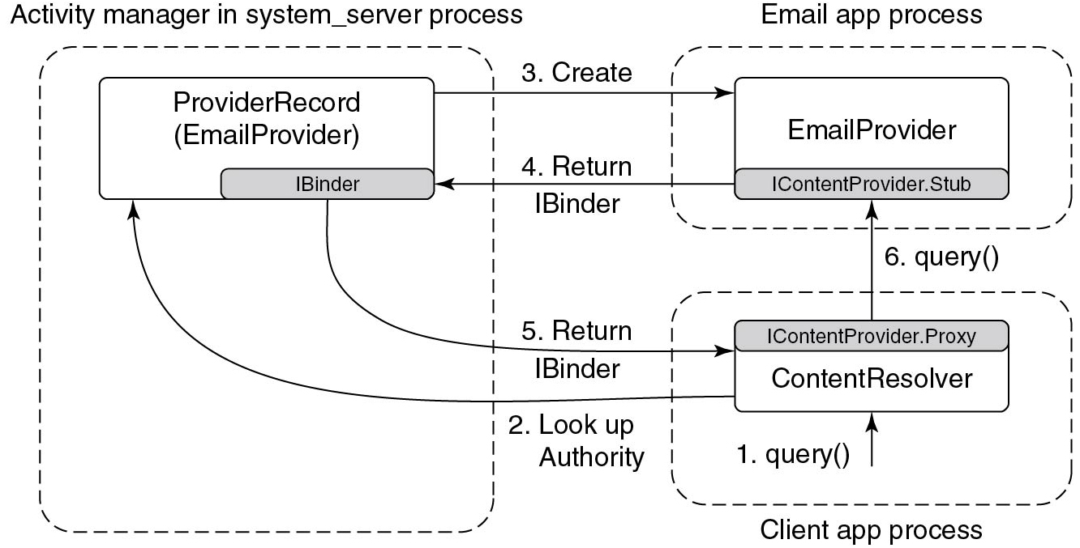
Content Providers
Figure 10.61 Interacting with a content provider.
Notes:
Long Description:
The figure consists of three dotted rectangular blocks. The first dotted rectangular block labeled Activity manager in the system server process consists of one rectangular block labeled Provider Record (Email Provider). Inside this block, there is another shaded rectangular block in the lower right corner labeled Ibinder. The second dotted rectangular block consists of an Email Provider block. At the bottom of the Email Provider block there is another shaded rectangular block labeled IcontentProvider.stub. The third dotted rectangular block labeled Client app process consists of a rectangular block labeled content resolver. Another shaded rectangular block on the top of the content resolver block is labeled IContentProvider.Proxy.The first arrow labeled query() in the client app process points to Content Resolver. The second arrow labeled LookUp authority points from contentresolver to Provider Record of the first rectangular block. The third arrow labeled create points from Provider Record block of the first rectangular block to Email Provider of Email app process block. The fourth arrow labeled Return IBinder points from the IContentProvider.stub from the email app process block to IBinder of the first rectangular block. The fifth arrow labeled Return IBinder points from IBinder of the first rectangular block to IContentProvider.Proxy of Client app process block. The sixth arrow labeled Query() points from IContentProvider.Proxy of client app process block to IcontentProvider.stub of Email app process block

Slide 72
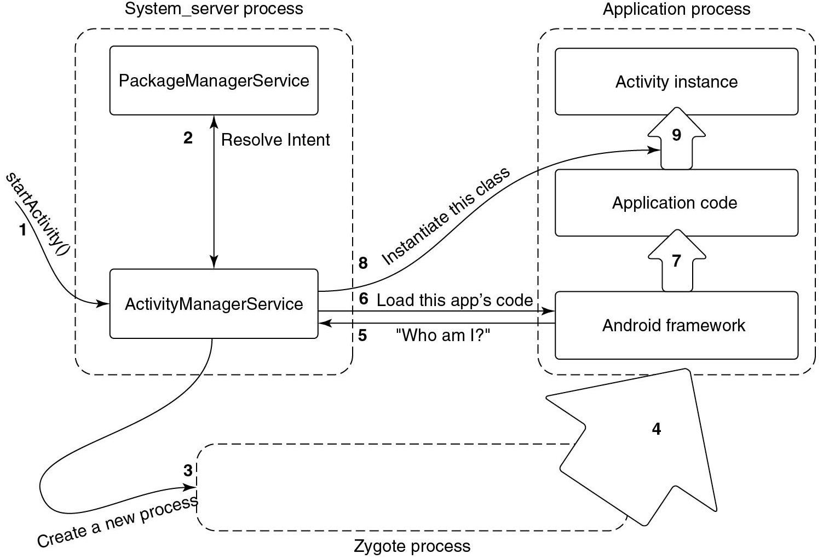
Starting an Application
Figure 10.62 Steps in launching a new application process.
Notes:
Long Description:
The figure consists of three rectangular dotted blocks labeled System server process, Zygote Process, and Application process. The System server process block consist of two rectangular blocks labeled PackageManagerService and ActivityManagerService. A one-sided arrow is pointing toward the ActivityManagerService block and labeled 1 and startActivity(). A two-sided arrow is connected between the PackageManagerService block and the ActivityManagerService block that is labeled 2 and Resolve Intent. The second rectangular block is labeled Zygote process and a one-sided arrow is pointing from ActivityManagerService to Zygote process that is labeled 3 and Create a new process. The Application process block is consist of three rectangular blocks labeled Activity instance, Application code, and Android framework. A one-sided arrow is pointed from the Zygote process block to the Application process block and labeled 4. Another arrow is pointing from the Android framework to the Application code and labeled 7 and from the Application code to the Activity instance and labeled 9. A one-sided arrow is pointing from the ActivityManagerService block to the ninth arrow. A one-sided arrow is pointing from the ActivityManagerService block to the Android framework block which is labeled 6 and Load this app‘s code. Another one-sided arrow is pointing from the Android framework block to the ActivityManagerService block which is labeled 5 and "Who am I question mark".

Slide 73
Types of Processes
Category | Description | Importance
SYSTEM | The system and daemon processes | − 900
PERSISTENT | Always-running application processes | − 800
FOREGROUND | Currently interacting with user | 0
VISIBLE | Visible to user | 100 - 199
PERCEPTIBLE | Something the user is aware of | 200
SERVICE | Running background services | 500
HOME | The home/launcher process (when not in foreground) | 600
CACHED | Processes not in use | 950 - 999
Figure 10.63 Process importance categories.

Slide 74
Process Importance (1)
Process | State | Importance
system | Core part of operating system | SYSTEM
phone | Always running for telephony stack | PERSISTENT
email | Current foreground application | FOREGROUND
camera | In use by email to load attachment | FOREGROUND
music | Running background service playing music | PERCEPTIBLE
media | In use by music app for accessing user’s music | PERCEPTIBLE
download | Downloading a file for the user | SERVICE
launcher | App launcher not current in use | HOME
maps | Previously used mapping application | CACHED
Figure 10.64 Typical state of process importance.

Slide 75
Process Importance (2)
Category | Description | Importance
system | Core part of operating system | SYSTEM
phone | Always running for telephony stack | PERSISTENT
email | Current foreground application | FOREGROUND
music | Running background service playing music | PERCEPTIBLE
media | In-use by music app for accessing user’s music | PERCEPTIBLE
download | Downloading a file for the user | SERVICE
launcher | App launcher not current in use | HOME
camera | Previously used by email | CACHED
maps | Previously used mapping application | CACHED+1
Figure 10.65 Process state after email stops using camera.

Slide 76
U I D s
U I D | Purpose
0 | Root
1000 | Core system (system ser ver process)
1001 | Telephony services
1013 | Low-level media processes
2000 | Command line shell access
10000–19999 | Dynamically assigned application U I D s
100000 | Start of secondary users
Figure 10.66 Common U I D assignments in Android.

Slide 77
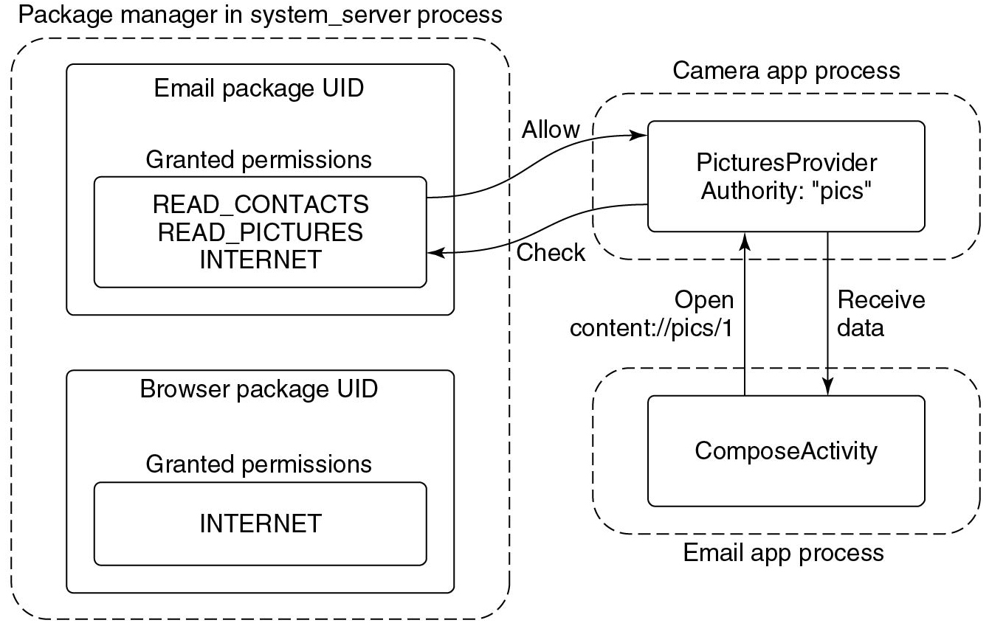
Permissions (1)
Figure 10.67 Requesting and using a permission.
Notes:
Long Description:
The figure shows three dotted rectangular blocks labeled Package manager in system server process, Email app process, and Camera app process. The first block consists of two rectangular blocks, the first block is labeled Email package U I D, Granted permissions which is again consist of rectangular block labeled READ CONTACTS READ PICTURES INTERNET, and the second block is labeled Browser package U I D Granted permissions which again consists of a rectangular block labeled INTERNET. The Camera app process block consists of a rectangular block labeled Picture Provider Authority: "pics". The Email app process block consists of a rectangular block labeled Compose Activity. A one-sided arrow is pointing from Compose Activity to the Camera app process block which is labeled Open content: slash slash pics slash 1. A one-sided arrow is pointing from the Camera app process to the Compose Activity which is labeled Receive data. A one-sided arrow is pointing from the Picture Provider Authority: "pics" to the READ CONTACTS READ PICTURES INTERNET which is labeled Check. A one-sided arrow is pointing from the READ CONTACTS READ PICTURES INTERNET to the Picture Provider Authority: "pics" which is labeled Allow.

Slide 78
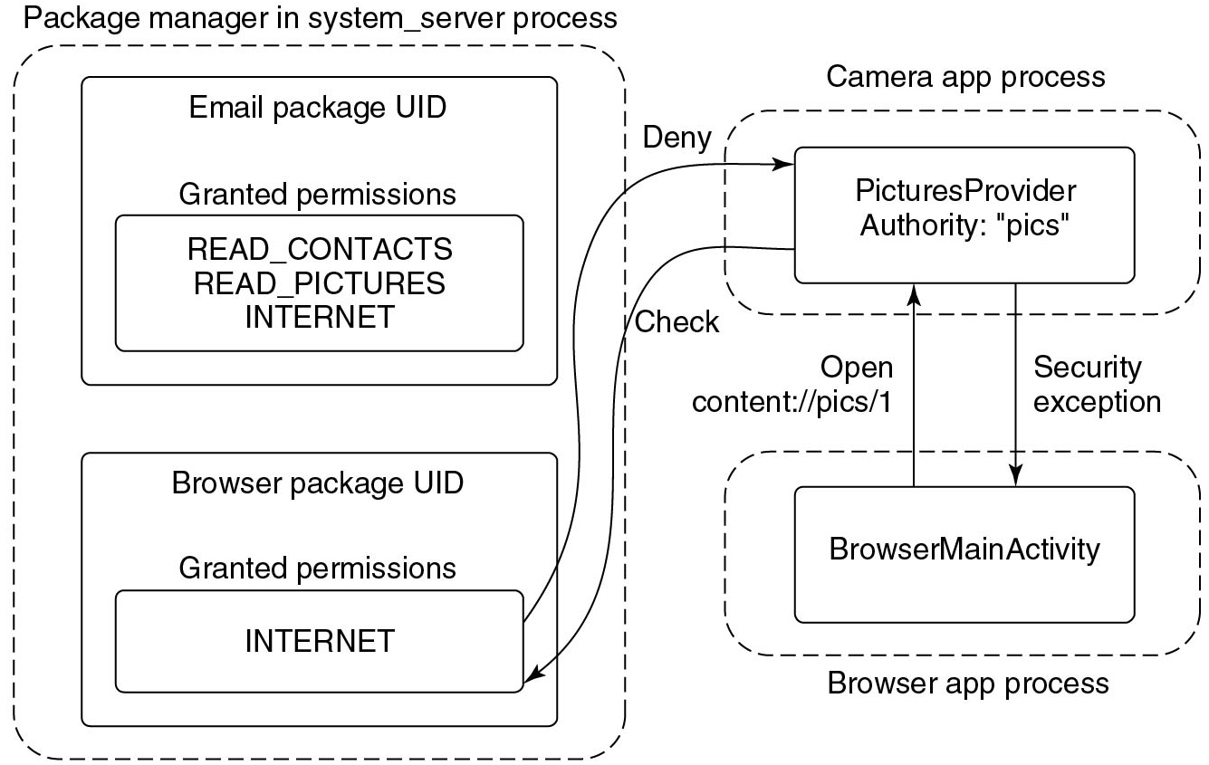
Permissions (2)
Figure 10.68 Accessing data without a permission.
Notes:
Long Description:
The figure shows three-dotted rectangular blocks labeled Activity manager in system server process, Email app process, and Camera app process. The first block consists of another rectangular block which is labeled Package manager in the system server process. It consists of two rectangular blocks, the first block is labeled Email package U I D, Granted permissions which again consists of a rectangular block labeled READ CONTACTS READ PICTURES INTERNET, and the second block is labeled Browser package U I D Granted permissions which again consists of a rectangular block labeled INTERNET. The Camera app process block is consist of a rectangular block labeled Picture Provider Authority: "pics". The Email app process block is consist of a rectangular block labeled Browser MainActivity. A one-sided arrow is pointing from Compose Activity to the Camera app process block which is labeled Open content: slash slash pics slash 1. A one-sided arrow is pointing from the Camera app process to the Compose Activity which is labeled Security exception. A one-sided arrow is pointing from the PicturesProvider Authority: "pics" to the INTERNET which is labeled Check. A one-sided arrow is pointing from the internet to the PicturesProvider Authority: "pics" which is labeled Deny.

Slide 79
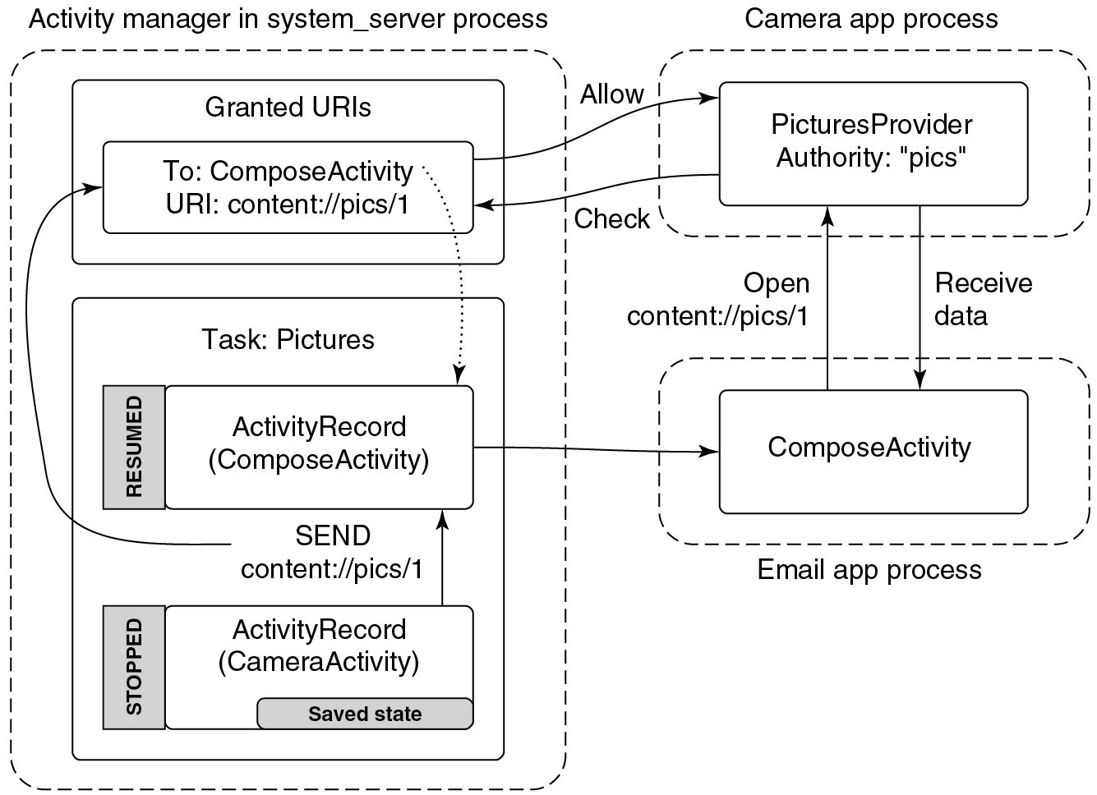
Content Providers (1)
Figure 10.69 Sharing a picture using a content provider.
Notes:
Long Description:
The figure consists of three dotted rectangular blocks labeled activity manager in system server process, Email app process, and Camera app process. The first block consists of another two rectangular blocks which are labeled Granted U R I s and Task: Pictures. The Granted U R I s block is consist of a rectangular block labeled To: Compose Activity U R I: content: slash slash pics slash 1. The Task: Pictures block is consists of another two rectangular blocks which are labeled ActivityRecord(Compose Activity) and another shaded rectangular block on the side of the block is labeled RESUMED and ActivityRecord (CameraActivity) and another shaded rectangular block on the side of the block is labeled STOPPED and Saved state block which is placed bottom of the block. A one sided arrow is pointing from ActivityRecord(CameraActivity) block to the ActivityRecord(Compose Activity) block which is labeled SEND content: slash slash pics slash 1, another arrow is pointing from this to To: Compose Activity U R I: content: slash slash pics slash 1 block. A dotted one sided arrow is pointing from To Compose Activity U R I: content: slash slash pics slash 1 to the ActivityRecord (Compose Activity). The Camera app process block is consist of a rectangular block labeled PicturesProvider Authority: "pics". The Email app process block is consist of a rectangular block labeledComposeActivity. A one-sided arrow is pointing from Compose Activity to the Camera app process block which is labeled Open content: slash slash pics slash 1. A one-sided arrow is pointing from the Camera app process to the Compose Activity which is labeled Receive data. A one-sided arrow is pointing from the PicturesProvider Authority: "pics" to the To: Compose Activity U R I: content: slash slash pics slash 1 which is labeled Check. A one sided arrow is pointing from the To: Compose Activity U R I: content: slash slash pics slash 1 to the PicturesProvider Authority: "pics" which is labeled Allow.

Slide 80
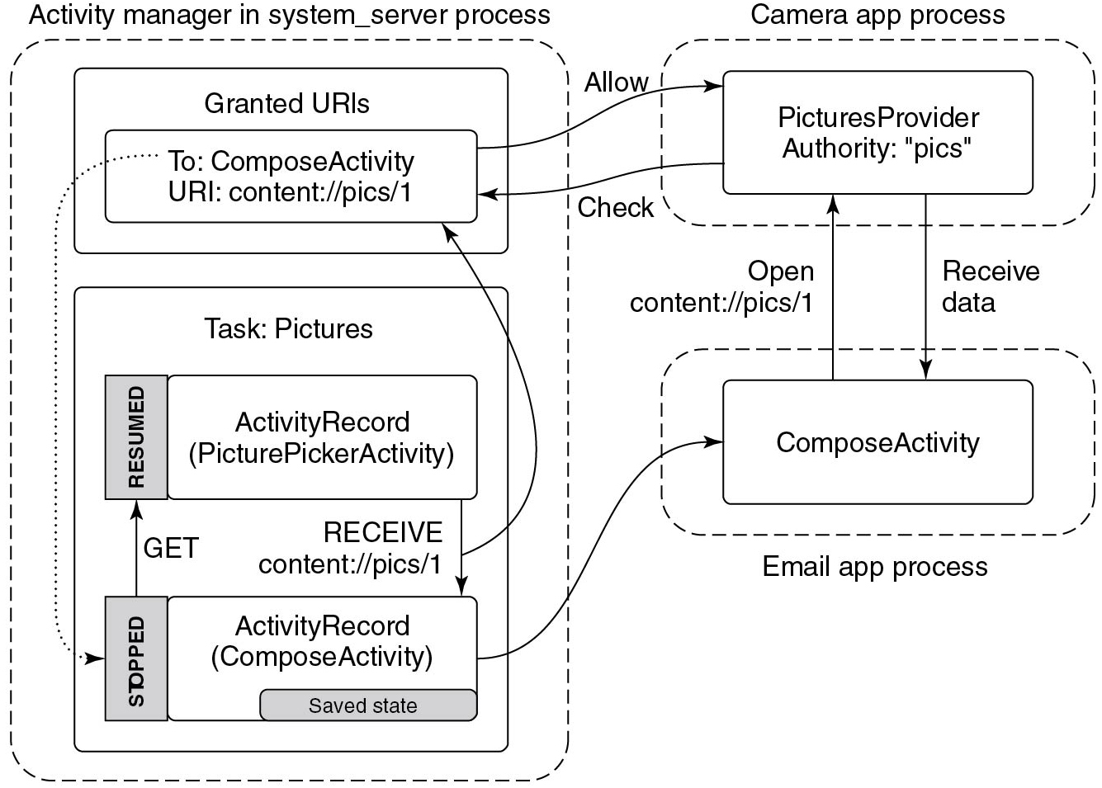
Content Providers (2)
Figure 10.70 Adding a picture attachment using a content provider.
Notes:
Long Description:
The figure shows three dotted blocks labeled Activity manager in system underscore server process, camera app process, and Email app process. In the first dotted rectangular block, there are two rectangular blocks. One labeled Granted U R I s consist of another rectangular block labeled To Compose Activity U R I:content: slash slash pics slash 1 and another rectangular block labeled Task: Pictures. It consists of two rectangular blocks one labeled ActivityRecord (PicturePicker Activity). A block labeled resumed is on the left side of the ActivityRecord block. Another rectangular block labeled ActivityRecord (Compose Activity) has a block labeled saved state at the lower right corner. A block labeled stopped is on the left corner. The second dotted block labeled camera app process consists of a rectangular block labeled Pictures Provider Authority: "pics". The third dotted block labeled Email app process consists of a rectangular block labeled Compose Activity. A one sided arrow is pointing from STOPPED to RESUMED labeled GET. Another one sided arrow is pointing from ActivityRecord (PicturePickerActivity) block to the ActivityRecord (Compose Activity) block which is labeled RECEIVE content: slash slash pics slash 1, another arrow is pointing from this arrow to the To: Compose Activity U R I: content: slash slash pics slash 1 block. A dotted one sided arrow is pointing from To: Compose Activity U R I: content: slash slash pics slash 1 block to the STOPPED block. A one-sided arrow is pointing from ActivityRecord (Compose Activity) to the Compose Activity block. Another one-sided arrow is pointing from Compose Activity to the PicturesProvider Authority: "pics" which is labeled Open content: slash slash pics slash 1. Another one-sided arrow is pointing from the Open content: slash slash pics slash 1 block to the Compose Activity to the PicturesProvider Authority: "pics" block which is labeled Receive data. A one-sided arrow is pointing from the To: Compose Activity U R I: content: slash slash pics slash 1 block to the PicturesProvider Authority: "pics" block which is labeled Allow. A one-sided arrow is pointing from the PicturesProvider Authority: "pics" block to the To: Compose Activity U R I: content: slash slash pics slash 1 block which is labeled Check.

Slide 81
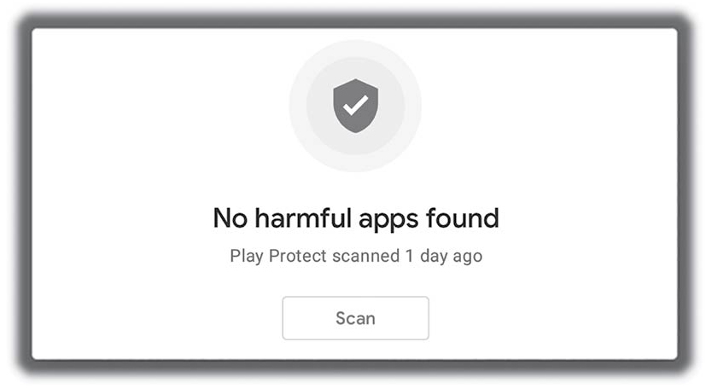
Security
Google L L C
Figure 10.71 The only thing most users care about security.
Notes:
Long Description:
The figure shows a rectangular block labeled No harmful apps found and play protect scanned 1 day ago. The scan block is shown at the lower end.

Slide 82
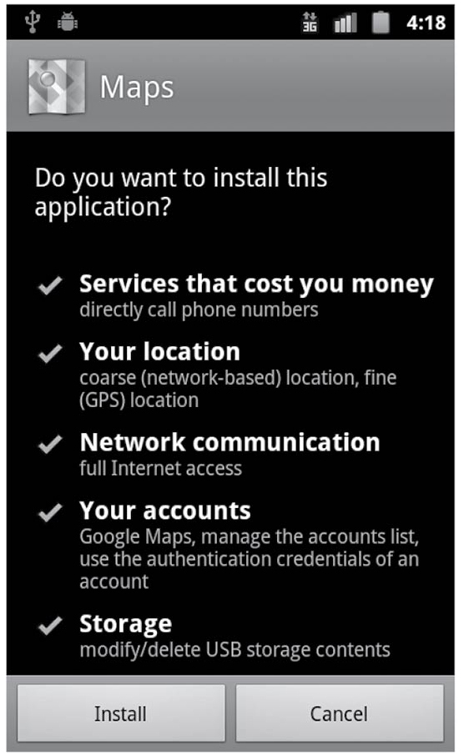
Permissions Revisited (1)
Google L L C
Figure 10.72 Confirming permission at install time (circa 2010).
Notes:
Long Description:
The screen is titled Maps and the first line is labeled Do you want to install this application. The second line is labeled with a tick mark Services that cost you money and directly call phone numbers. The third line is labeled with a tick mark Your location and coarse (network-based) location, fine (G P S) location. The fourth line is labeled with a tick mark Network communication and full internet access. The fifth line is labeled with a tick mark Your accounts and Google maps, manage the account list, use the authentication credentials of an account. The sixth line is labeled with a tick mark Storage and modify or delete U S B storage contents. The lower end of the screen consists of two blocks that are labeled Install and cancel.

Slide 83
Permissions (2)
Permission | Description
SEND SMS | COST MONEY
CALL PHONE | COST MONEY
RECEIVE SMS | MESSAGES
READ SMS | MESSAGES
WRITE SMS | MESSAGES
READ CONTACTS | PERSONAL INFO
WRITE CONTACTS | PERSONAL INFO
READ CALENDAR | PERSONAL INFO
WRITE CALENDAR | PERSONAL INFO
BODY SENSORS | PERSONAL INFO
ACCESS FINE LOCATION | LOCATION
ACCESS COARSE LOCATION | LOCATION
INTERNET | NETWORK
Figure 10.73 Select list of install-time dangerous permissions.

Slide 84
Permissions (3)
Permission | Description
BLUETOOTH | NETWORK
MANAGE ACCOUNTS | ACCOUNTS
MODIFY AUDIO SETTINGS | HARDWARE CONTROLS
RECORD AUDIO | HARDWARE CONTROLS
CAMERA | HARDWARE CONTROLS
PROCESS OUTGOING CALLS | PHONE CALLS
MODIFY PHONE STATE | PHONE CALLS
READ PHONE STATE | PHONE CALLS
WRITE SETTINGS | SYSTEM TOOLS
SYSTEM ALERT WINDOW | SYSTEM TOOLS
WAKE LOCK | SYSTEM TOOLS
READ EXTERNAL STORAGE | STORAGE
WRITE EXTERNAL STORAGE | STORAGE
Figure 10.73 Select list of install-time dangerous permissions.

Slide 85
Permissions (4)
Permission | Group
SET ALARM | SET ALARM
ACCESS NETWORK STATE | NETWORK
ACCESS WIFI STATE | NETWORK
GET ACCOUNTS | ACCOUNTS
VIBRATE | HARDWARE CONTROLS
FLASHLIGHT | HARDWARE CONTROLS
EXPAND STATUS BAR | SYSTEM TOOLS
KILL BACKGROUND PROCESSES | SYSTEM TOOLS
SET WALLPAPER | SYSTEM TOOLS
Figure 10.74 Select list of install-time normal permissions.

Slide 86

Permissions (5)
Google L L C
Figure 10.75 Android 6.0 runtime permission prompt.
Notes:
Long Description:
The figure shows a rectangular block labeled Allow Permission Demo to access this device's location question mark And DENY ALLOW options are labeled lower right corner of the rectangular block.

Slide 87
Permissions (6)
Runtime prompt | Permissions
CONTACTS | READ CONTACTS, WRITE CONTACTS, GET ACCOUNTS
CALENDAR | READ CALENDAR, WRITE CALENDAR
SMS | SEND SMS, RECEIVE SMS, READ SMS
STORAGE | READ EXTERNAL STORAGE, WRITE EXTERNAL STORAGE
LOCATION | ACCESS FINE LOCATION, ACCESS COARSE LOCATION
PHONE | READ PHONE STATE, CALL PHONE, PROCESS OUTGOING CALLS
MICROPHONE | RECORD AUDIO
CAMERA | CAMERA
SENSORS | BODY SENSORS
Figure 10.76 Select list of runtime permissions.

Slide 88
Permissions (7)
Permission
SET ALARM
ACCESS NETWORK STATE
ACCESS WIFI STATE
VIBRATE
FLASHLIGHT
EXPAND STATUS BAR
KILL BACKGROUND PROCESSES
SET WALLPAPER
INTERNET
BLUETOOTH
MODIFY AUDIO SETTINGS
WAKE LOCK
Figure 10.77 Select list of auditable normal permissions.

Slide 89

Permissions (8)
Google L L C
Figure 10.78 Android 10’s background versus. foreground location prompt.
Notes:
Long Description:
The figure shows a rectangular block that is divided into four layers labeled Allow Permission Demo to access this device's location question mark, Allow all the time, Allow only while using the app, and Deny.

Slide 90

Permissions (9)
Google L L C
Figure 10.79 Android 11’s “only this once” prompt.
Notes:
Long Description:
The figure shows a rectangular block that is divided into four layers labeled Allow Permission Demo to access this device's location question mark, While using the app, Only this time, and Deny.

Slide 91

Permissions (10)
Google L L C
Figure 10.80 Android 11’s location permission settings.
Notes:
Long Description:
The screen is titled location permission, permission demo. Location access for this app: The four options given are: Allow all the time, Allow only while using the app, Ask every time, and Deny. Allow only while using the app is selected.

Slide 92

Permissions (11)
Google L L C
Figure 10.81 Android 12’s coarse versus. fine prompt.
Notes:
Long Description:
The figure shows a rectangular block that is divided into five layers labeled Allow Permission Demo to access this device's location, the second layer consists of two circles labeled Precise and Approximate, While using the app, Only this time, and Deny.

Slide 93

Permissions (12)
Google L L C
Figure 10.82 Android 12’s privacy dashboard showing “location” details.
Notes:
Long Description:
The figure shows a display of the phone which gives information about the Location usage that is labeled at the top of the display and a Timeline of when your apps used your location in the past 24 hours. The figure consists of five lines. The first line is labeled 6.04 A M Music App and the second line is labeled 2.03 A M Map App and 32 minutes. The third line is labeled 8.24 A M New App. The fourth line is labeled 2.11 A M Task App. The fifth line is labeled 11.14 A M Email App.

Slide 94

Battery Use (1)
Google L L C
Figure 10.83 Android’s early battery use screen.
Notes:
Long Description:
The figure shows a display of the phone which gives information about the 5h 45m 24s on the battery that is labeled at the top of the display and the display consists of seven lines labeled Display 76 percent, Cell standby 7 percent, Phone idle 5 percent, Android system 4 percent, Android O S 3 percent, Gmail 3 percent and Voice search 2 percent.

Slide 95

Battery Use (2)
Google L L C
Figure 10.84 Doze and maintenance windows.
Notes:
Long Description:
The figure shows a horizontal line that is labeled time. The five vertical lines are connected to this line and the first line is labeled screen off stationary on battery, the second line is labeled Doze, and the third line is labeled Doze and maintenance window.

Slide 96

Copyright
This work is protected by United States copyright laws and is provided solely for the use of instructors in teaching their courses and assessing student learning. Dissemination or sale of any part of this work (including on the World Wide Web) will destroy the integrity of the work and is not permitted. The work and materials from it should never be made available to students except by instructors using the accompanying text in their classes. All recipients of this work are expected to abide by these restrictions and to honor the intended pedagogical purposes and the needs of other instructors who rely on these materials.

